Slide 1
Saarland University
– European in spirit since 1948 –
Cutting-edge research | International | Diverse

Slide 2
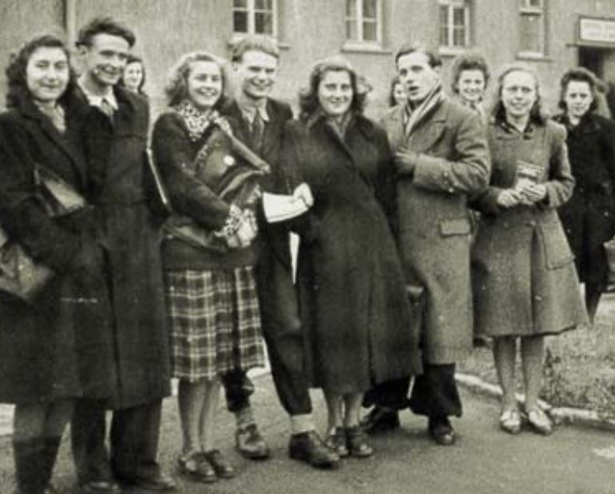
Fostering the European spirit for more than 70 years
‘Our aim is to shape this university into an instrument of a true European spirit.’
Jean Barriol, the first Rector of Saarland University (1948)
The university was founded in 1948 under the patronage of the French government and the University of Nancy.
The very first steps were taken in 1946 with the introduction of clinical training courses in Homburg.
University teaching commenced in 1948 in the former Below Barracks located a few kilometres from Saarbrücken.
Number of students at that time: 638

Slide 3
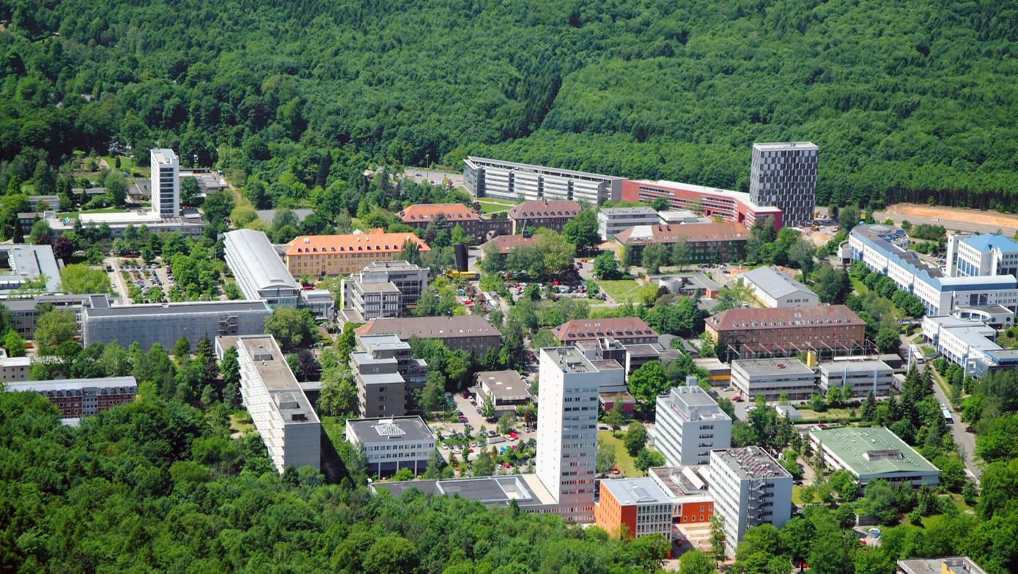
A campus university
in the heart of Europe and with global reach

Slide 4
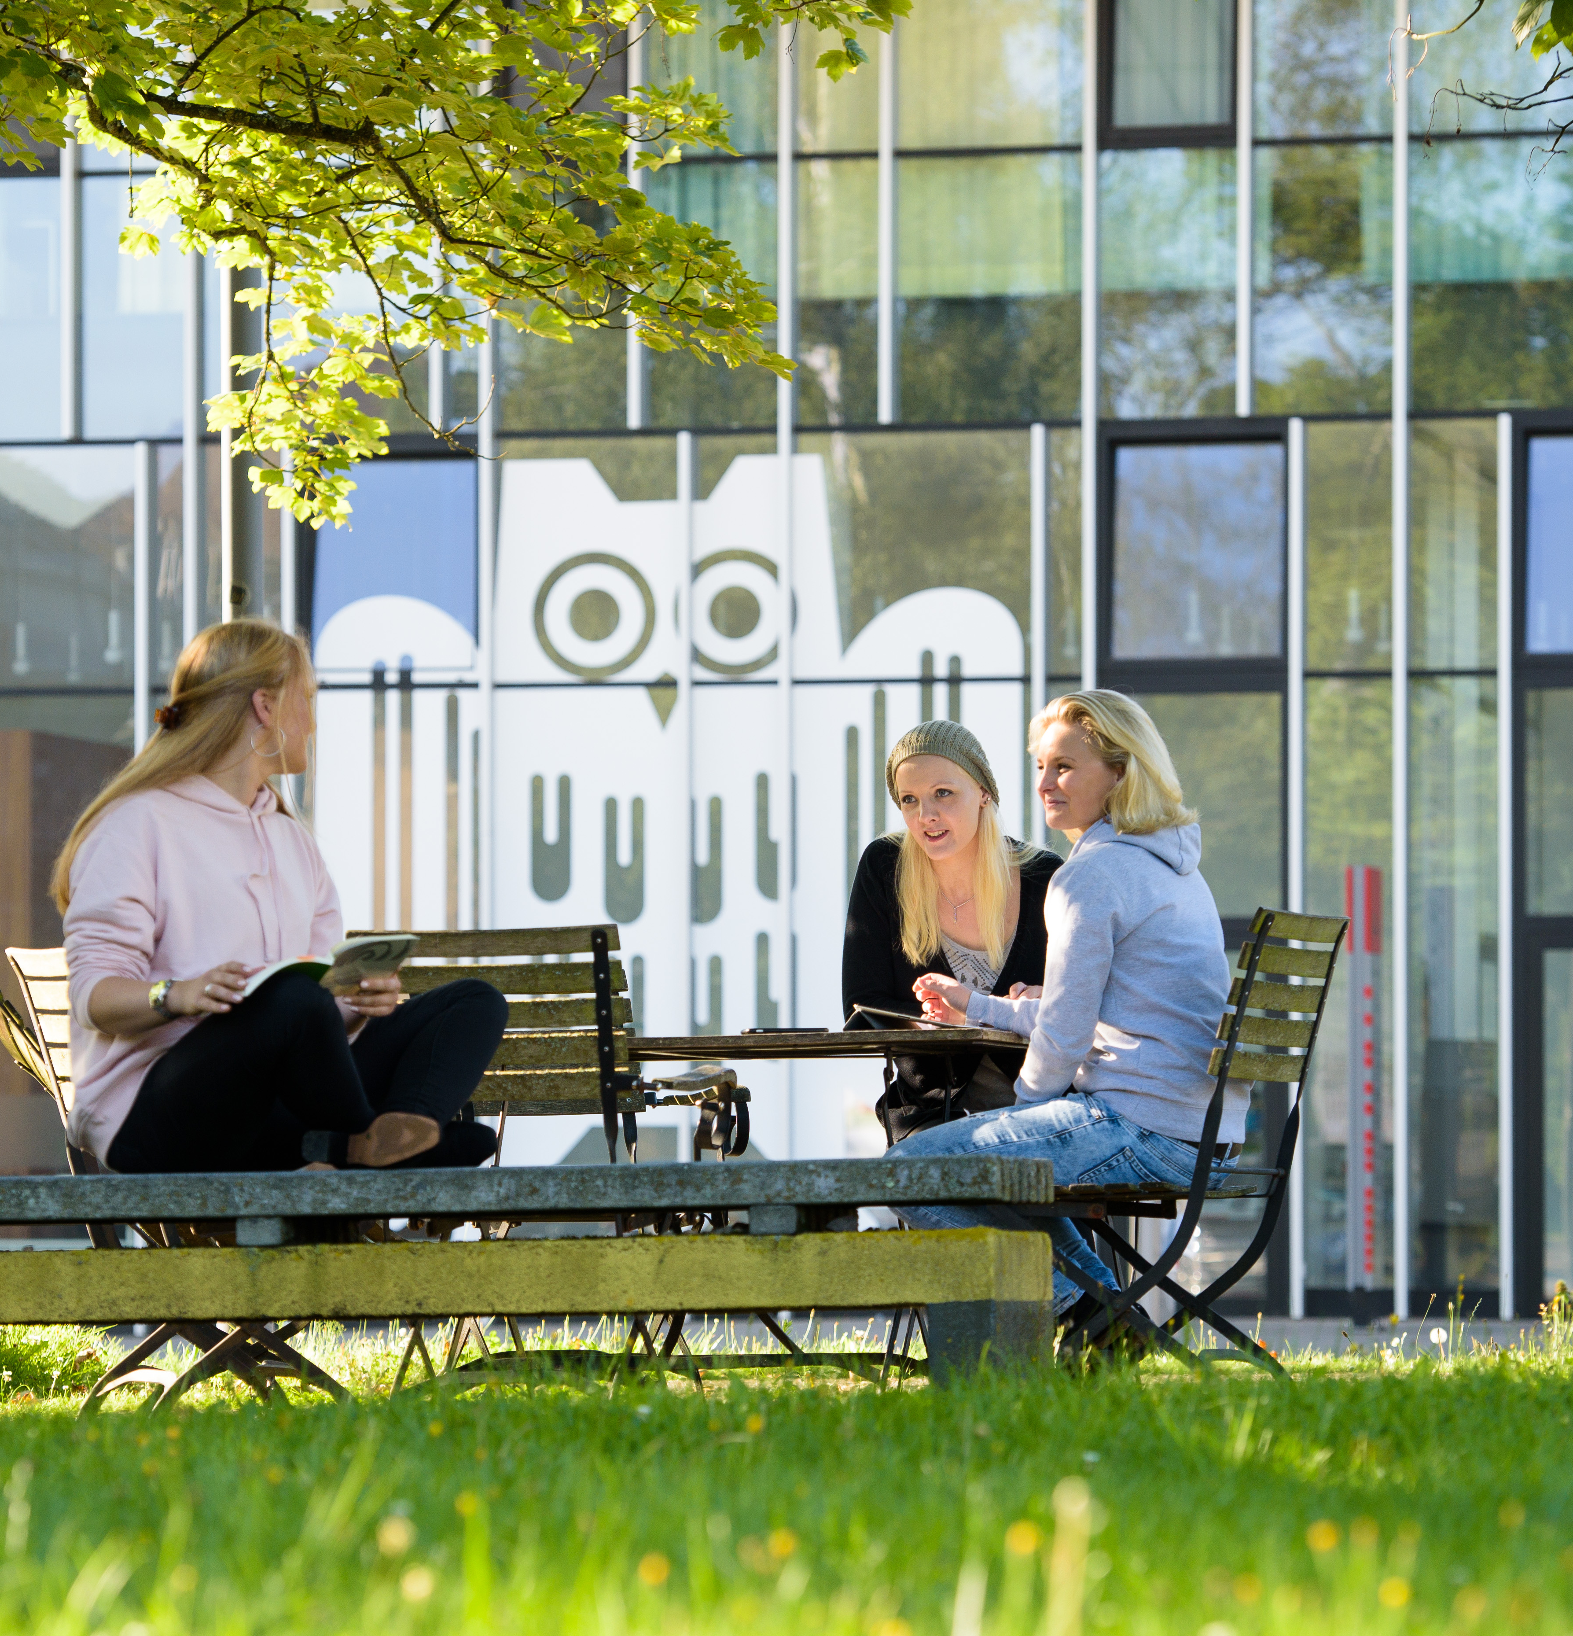
Six Faculties
Saarbrücken Campus
Human and Business Sciences
Mathematics and Computer Science
Natural Sciences and Technology
Humanities
Law
Homburg Campus
Medical Faculty and Saarland University Medical Center

Slide 5
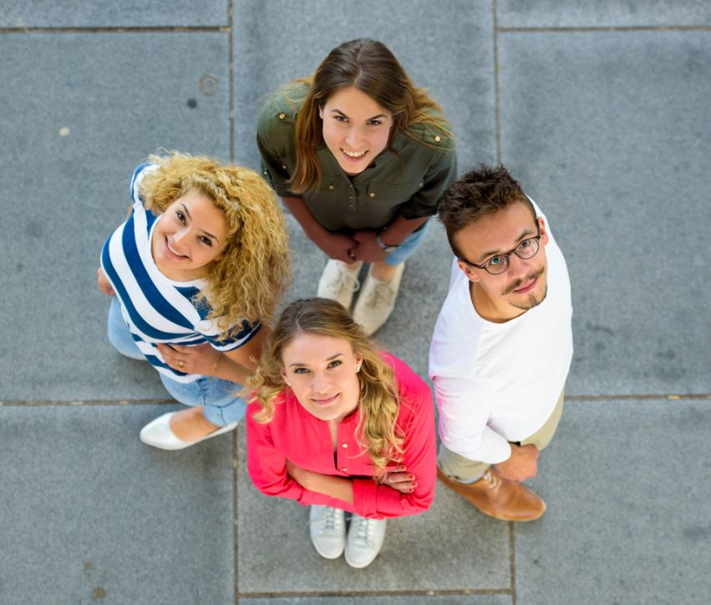
The university’s greatest asset? Our staff and students
We have
approximately 17,000 students, of whom 20 percent are international students
around 280 professors and junior professors
approximately 1600 academic research associates
around 1300 student teaching and research assistants
51 trainees and apprentices
Saarland University is one of the largest employers in Saarland, with a workforce of around 4700.

Slide 6
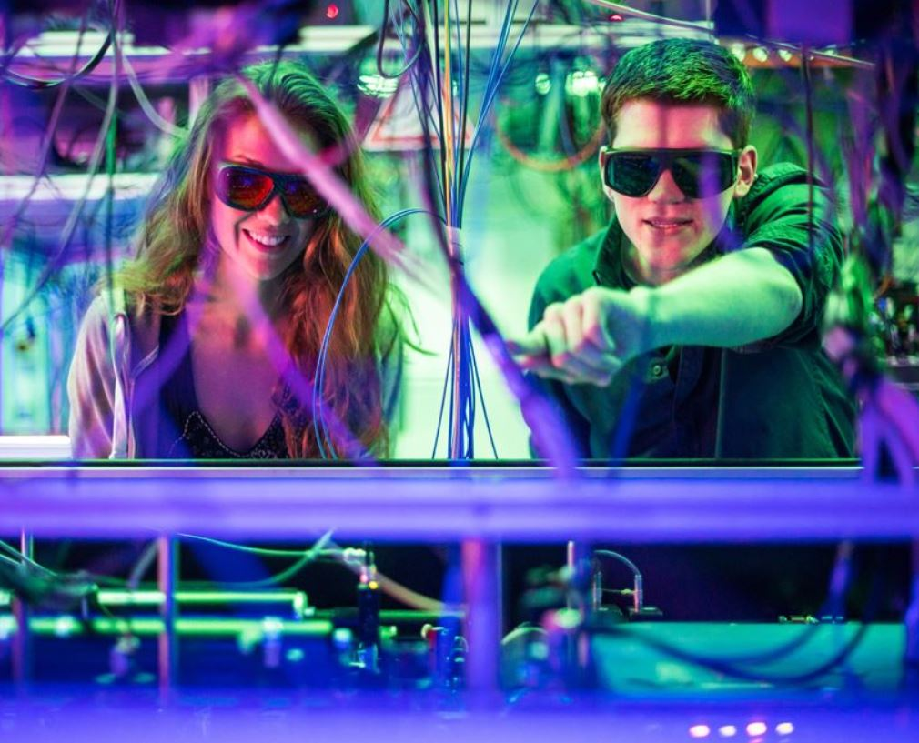
Cutting-edge research
3 Collaborative Research Centres
5 Transregional Collaborative Research Centres
3 sub-projects in external Collaborative Research Centres
5 Research Training Groups
Numerous research projects and international collaborative projects, which currently include 30 projects in the EU’s Research and Innovation programme Horizon 2020. Around 150 projects are funded by the German Research Foundation (DFG) and around 180 by the federal government.
Numerous international prizes and awards

Slide 7
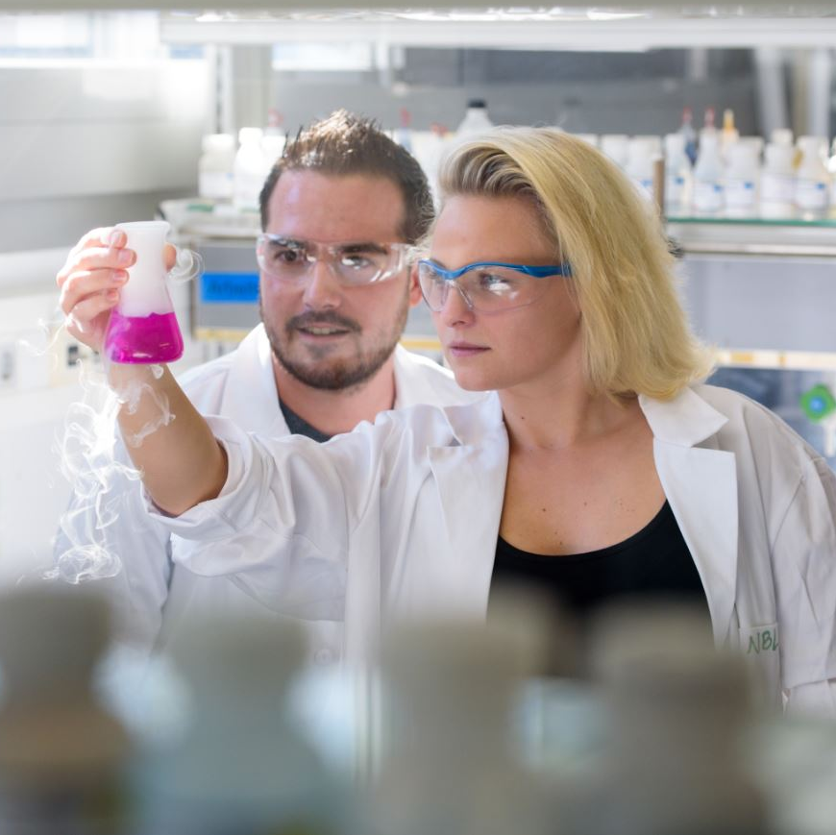
Computer Science
NanoBioMed – Life Science and Materials
Europe
Our core strategic research areas

Slide 8
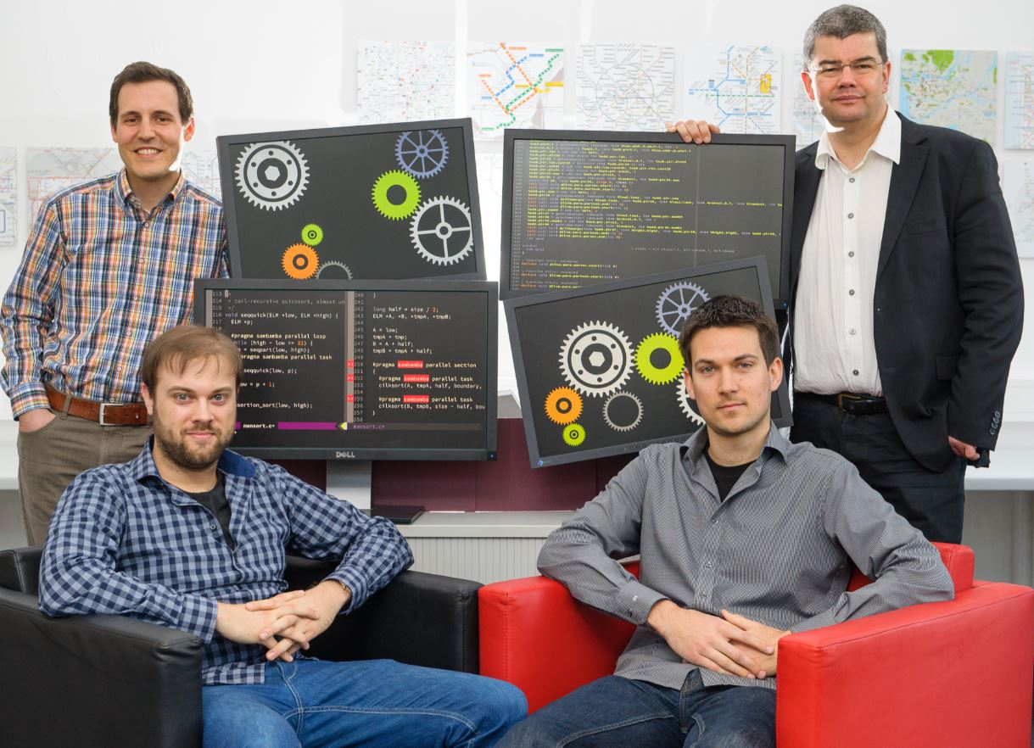
Saarland Informatics Campus – A global player
Saarbrücken is one of the world’s leading centres for computer science and informatics
Researchers at SIC have received multiple awards: 30 ERC Grants, 7 Leibniz Prize winners
900 IT research scientists
3 university departments that collaborate very closely: Computer Science, Mathematics and Language Science and Technology
5 world-renowned research institutes 76 research groups, 400 PhD students
2100 students from more than 81 countries
24 undergraduate and graduate degree programmes

Slide 9
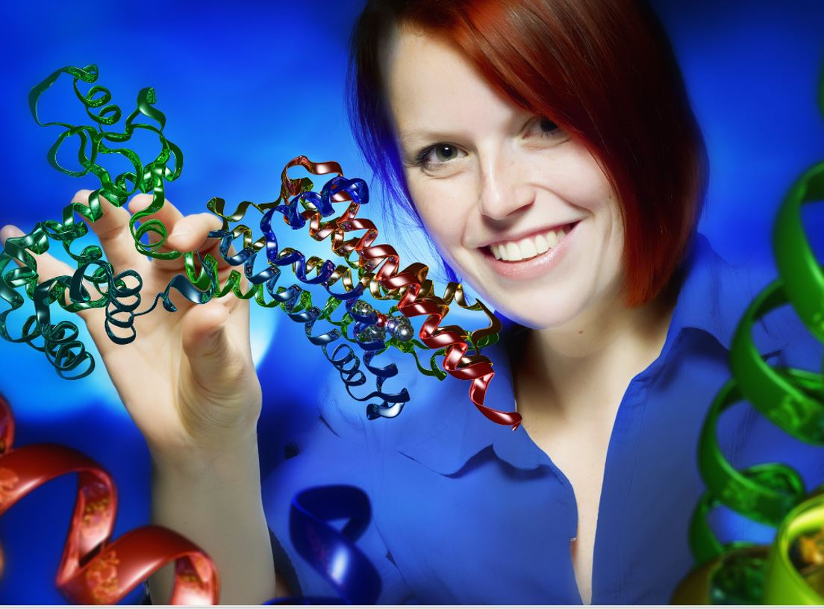
NanoBioMed – Multidisciplinary collaboration at its best
More than 600 researchers working at the interfaces of medicine, pharmaceutical science, the life sciences and bioinformatics
More than 300 researchers working in the fields of materials science and technology
Interdisciplinary research activities in nano-biotech, human and molecular biology, molecular medicine and in the modelling of biological systems
Numerous externally funded research projects and international collaborative programmes

Slide 10
Europe! European through and through!
Interdisciplinary European research in all faculties, with special focus on France
‘European University’: Transform4Europe The cross-border university alliance University of the Greater Region
Numerous degree programmes and certificates (e.g. the Europaicum) with a strong European focus
European studies programme with a choice of three areas of specialization
Europa-Kolleg CEUS, which also hosts the European visiting professorship | Europa-Institut with its two sections ‘Law’ and ‘Economics’ | Frankreichzentrum | Centre juridique franco-allemand

Slide 11
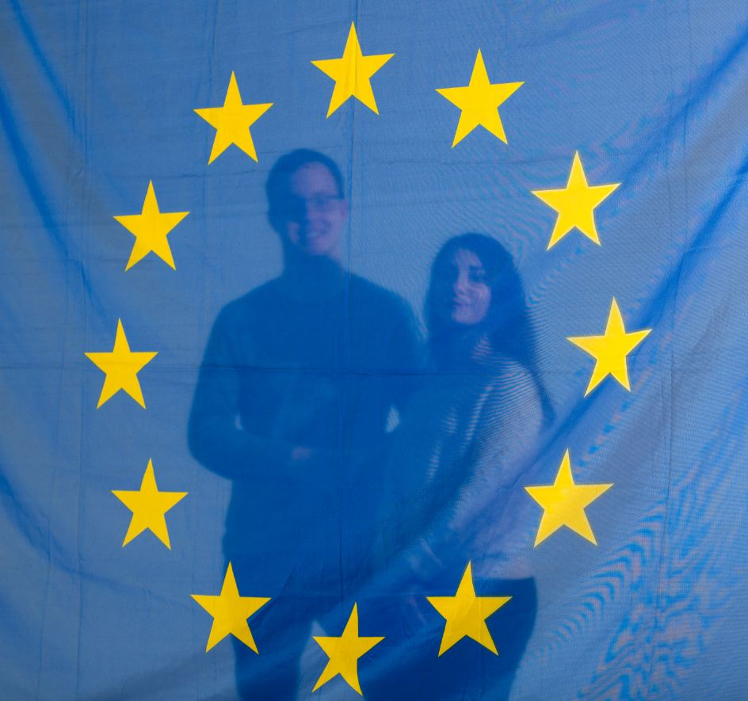
A university alliance for
a new generation of
young Europeans
who collaborate across subject boundaries to acquire digital, intercultural and entrepreneurial skills
European higher
education and training
for 116,000 students offering joint study programmes,
shared platforms, innovative approaches to teaching and an extensive mobility programme that facilitates close links between the seven universities in the
T4E alliance
European University:
Transform4Europe
T4E
An EU-supported initiative since 2020
Seven
partner universities in Spain, Estonia, Poland, Bulgaria, Italy and Lithuania

Slide 12
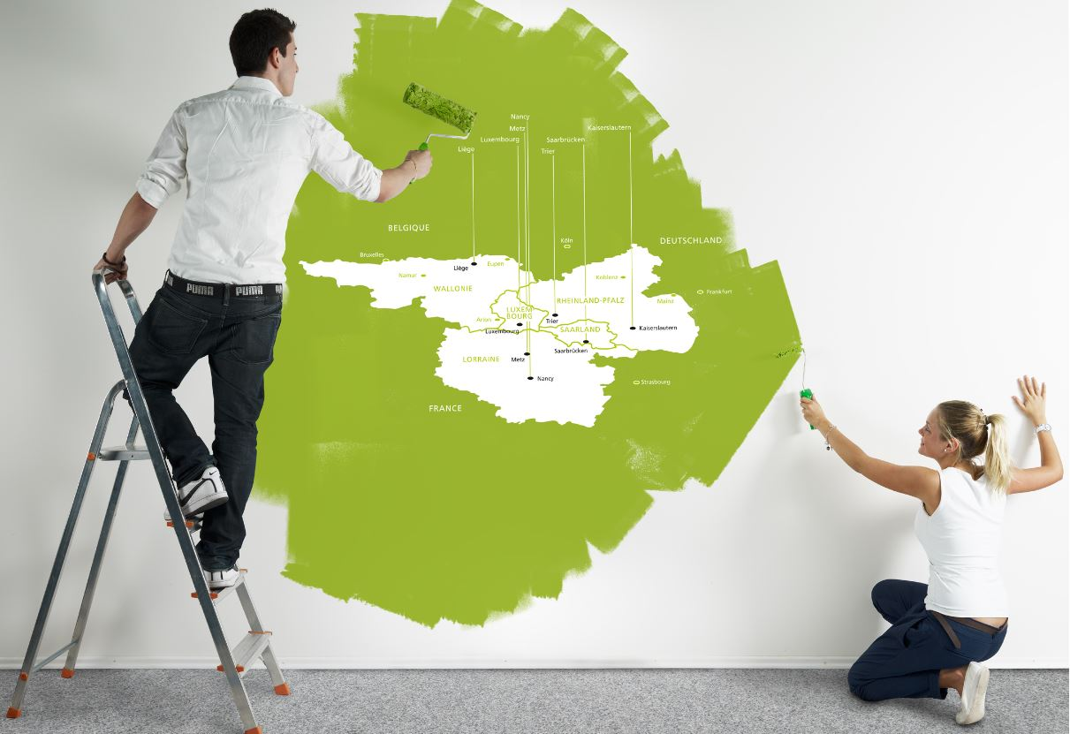
A dynamic network in the heart of Europe:
The University of the Greater Region
Six universities in Germany, France, Belgium and Luxembourg

Slide 13
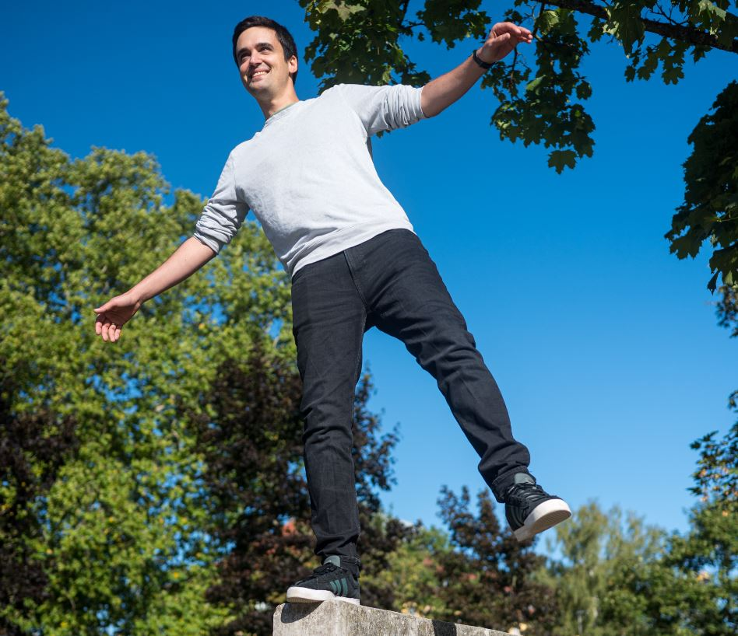
What makes us special? Crossing boundaries
At Saarland University our great strength has always been to go beyond the boundaries that are typically drawn between cultures, academic disciplines, economies and societies.
A campus where everything is close at hand fosters interdisciplinary collaboration and encourages close ties between research and teaching.
Interdisciplinary cooperation has always been a defining feature of Saarland University. Examples include business informatics, legal informatics and bioinformatics, language technology, nano-biotechnology, cultural studies in historical perspective, intercultural communication, quantum engineering.

Slide 14
All the big players in one place
Research networks provide an excellent working environment for early career researchers
CISPA – Helmholtz Center for Information Security | German Research Center for Artificial Intelligence (DFKI) | Max Planck Institute for Computer Science Max Planck Institute for Software Systems | Dagstuhl Castle – Leibniz Centre for Informatics
Helmholtz Institute for Pharmaceutical Research, Saarland (HIPS) | Leibniz Institute for New Materials (INM) | Steinbeis Research Center for Amorphous Metals | Steinbeis Materials Engineering Center Saarland (MECS)
Fraunhofer Institute for Biomedical Engineering (IBMT) | Fraunhofer Institute for Non-Destructive Testing (IZFP) | Center for Mechatronics and Automation Technology (ZeMA) | Korea Institute of Science and Technology Europe (KIST Europe)

Slide 15
Studying at Saarland University: Variety and depth
A total of 146 study programmes:
80 undergraduate degree programmes – Bachelor’s degrees / state examinations (Staatsexamen)
55 Master’s degree programmes
11 advanced professional study programmes
35 international degree programmes, most of which lead to a double- or triple-degree qualification
Over 20 certificates offering supplementary qualifications in specialist fields
The Language Centre offers courses on 15 languages

Slide 16
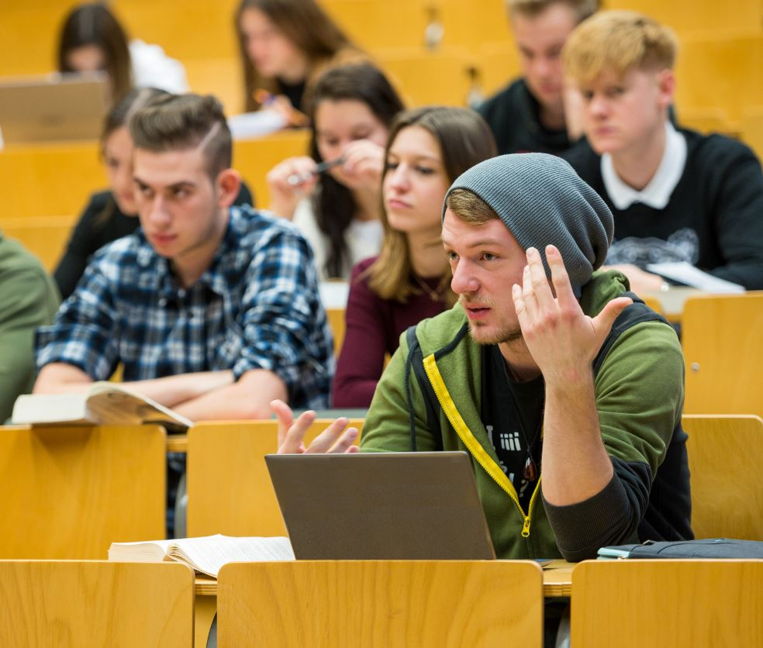
Officially recognized for teaching excellence
Saarland University was one of the first universities in Germany to receive official quality assurance accreditation for providing an ideal environment for successful academic study.
Effective quality management: Continuous development and improvement of teaching and study programmes
As a medium-sized university with a reputation for excellence, Saarland University offers personal academic supervision with students often learning in small groups.
Centre for Key Competencies and University Didactics: Acquisition of cross-disciplinary skills

Slide 17
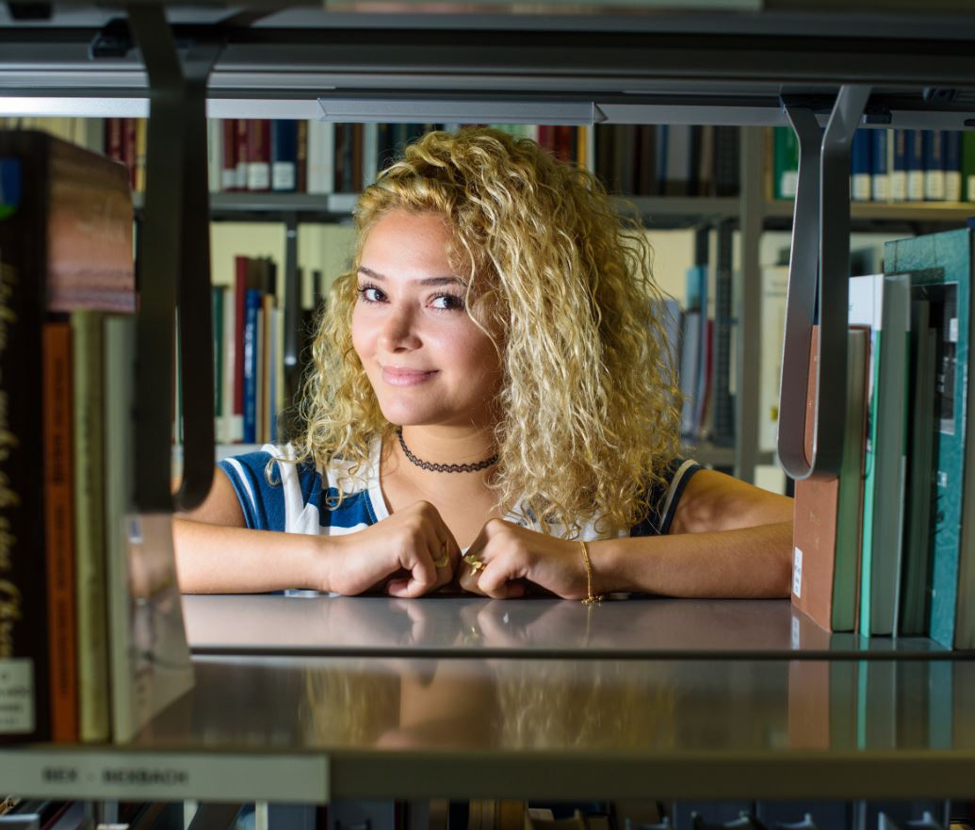
Getting off to a good start!
Preparatory courses and mentoring initiatives help students just starting out at university.
Study programmes that offer students opportunities to put their knowledge and skills into practice.
Students can contribute to departmental and institute research projects at an early stage of their university education.
The Career Center can assist with career planning and with transitioning from university to the workplace. Students can take their first steps in a business start-up while still studying.

Slide 18
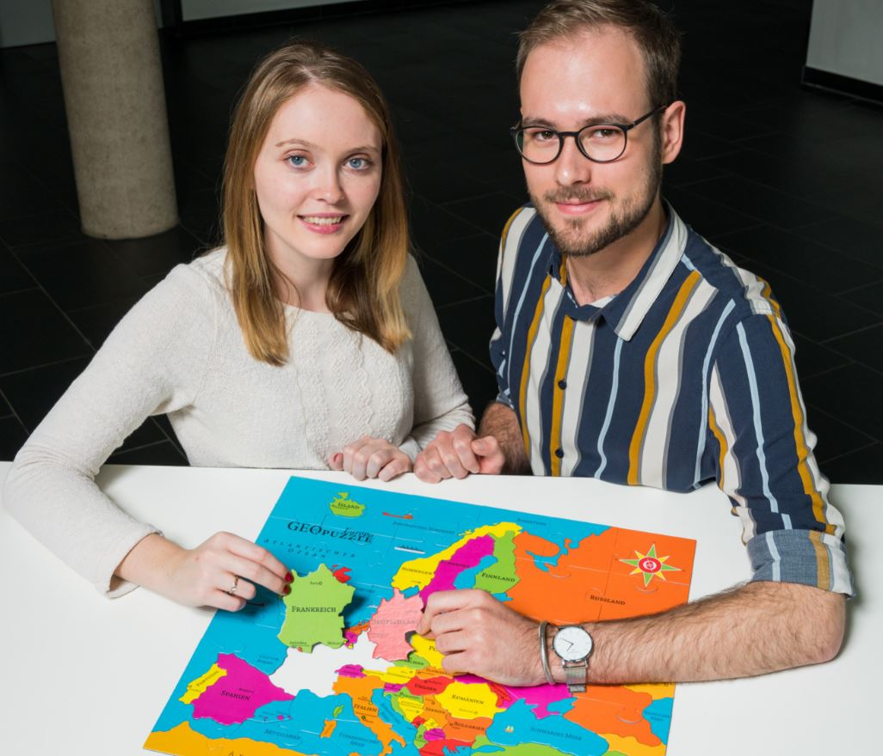
Opportunities around the world
The International Office is the main coordinating office for incoming international students and for home students looking to study abroad.
Exchange programmes for university research and teaching staff at hundreds of partner universities around the world, many of which are in Europe.
Support for students who want to organize a study abroad period outside of existing exchange programmes. Opportunities for international work placements and internships.
The Welcome Center provides assistance to international students and to visiting foreign academics and scholars.

Slide 19
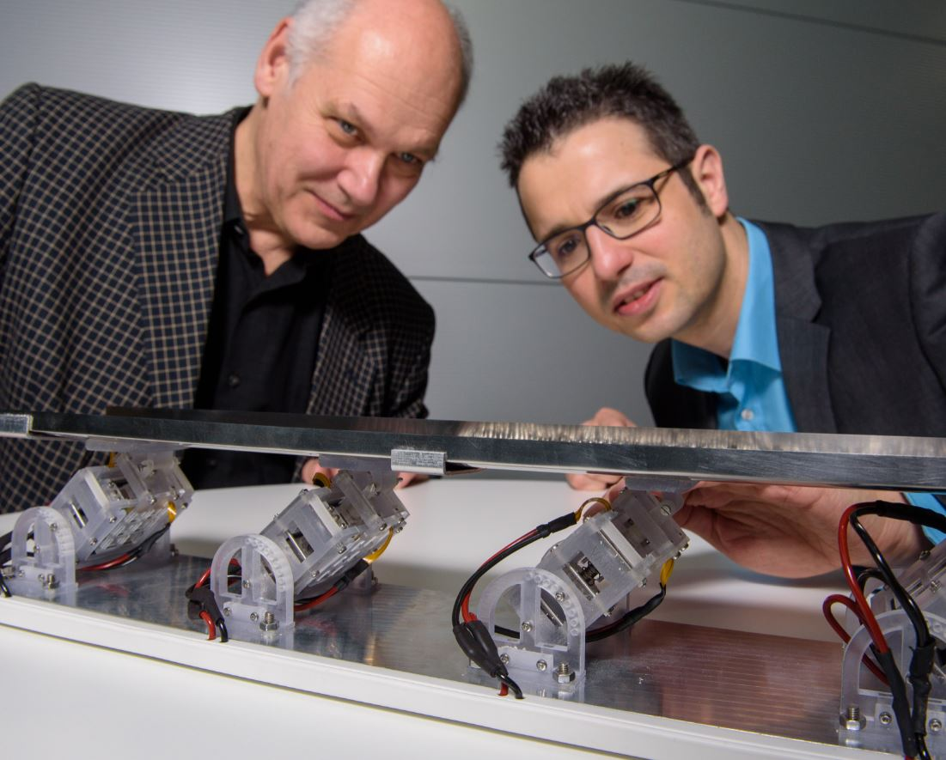
Entrepreneurial spirit
The ‘Entrepreneurial Campus Saar’ initiative
Recognized by the federal government in its EXIST Business Start-Up programme Very highly ranked in Germany's ‘Start-Up Radar’ league tables, described as a university with an ‘outstanding start-up culture’.
3 incubator centres: more than 520 start-ups Science Park located right next to campus
Young entrepreneurs benefit from outstanding guidance and support services, which are also available to students before they graduate.
Active technology transfer Patent utilization agency
Continuing Education: CEC Saar

Slide 20
At the heart of Europe and with global reach Picture credits: Oliver Dietze, dasbilderwerk (9,11), das Luftbildcentrum (3), Universitätsarchiv (2)

