Slide 1
Saarland University
– European in spirit since 1948 –
Cutting-edge research | International | Diverse

Slide 2
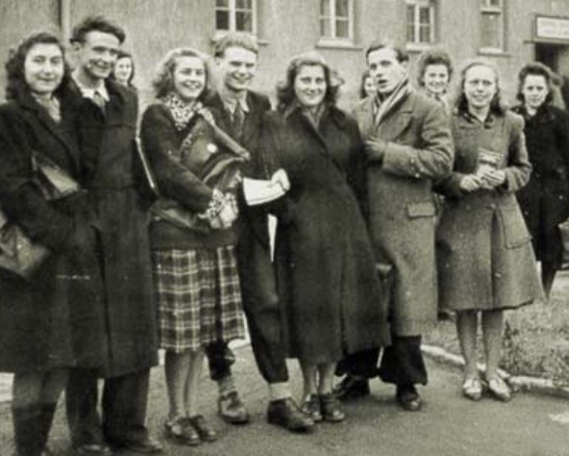
Fostering the European spirit for more than 70 years
‘Our aim is to shape this university into an instrument of a true European spirit.’
Jean Barriol, the first Rector of Saarland University (1948)
The university was founded in 1948 under the patronage of the French government and the University of Nancy.
The very first steps were taken in 1946 with the introduction of clinical training courses in Homburg.
University teaching commenced in 1948 in the former Below Barracks located a few kilometres from Saarbrücken.
Number of students at that time: 638

Slide 3
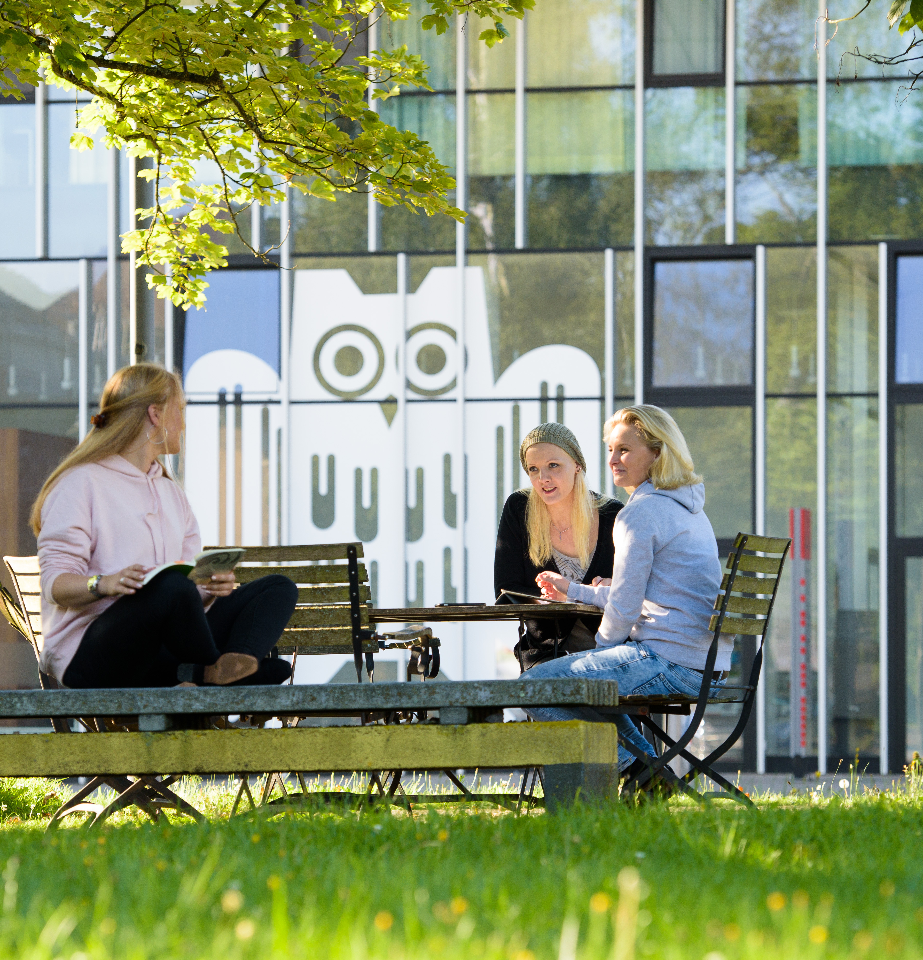
1 University – 2 Sites
Six Faculties
Saarbrücken Campus
Human and Business Sciences
Mathematics and Computer Science
Natural Sciences and Technology
Humanities
Law
Homburg Campus
Medical Faculty and Saarland University Medical Center

Slide 4
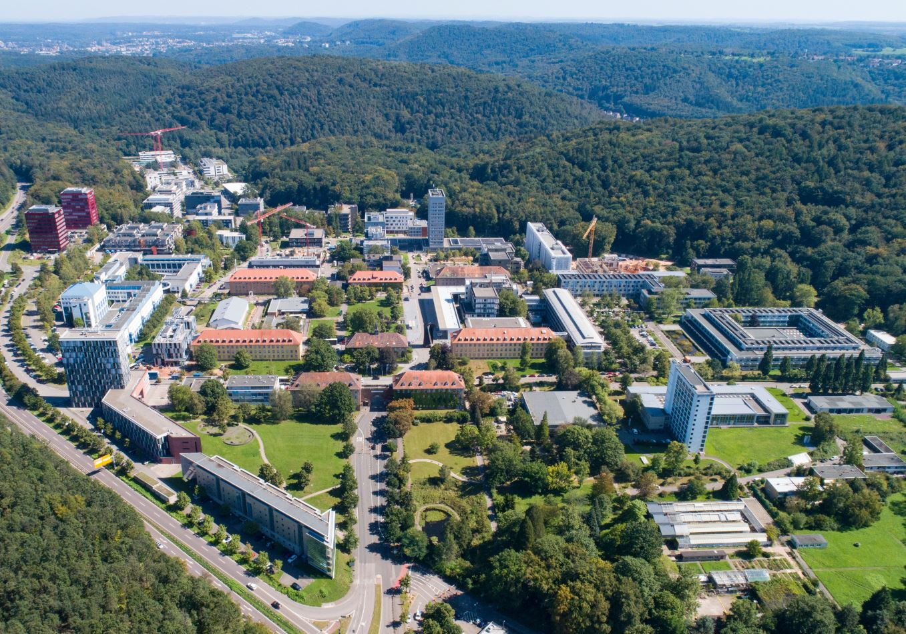
A campus university
Saarbrücken campus
in the heart of Europe and with global reach

Slide 5
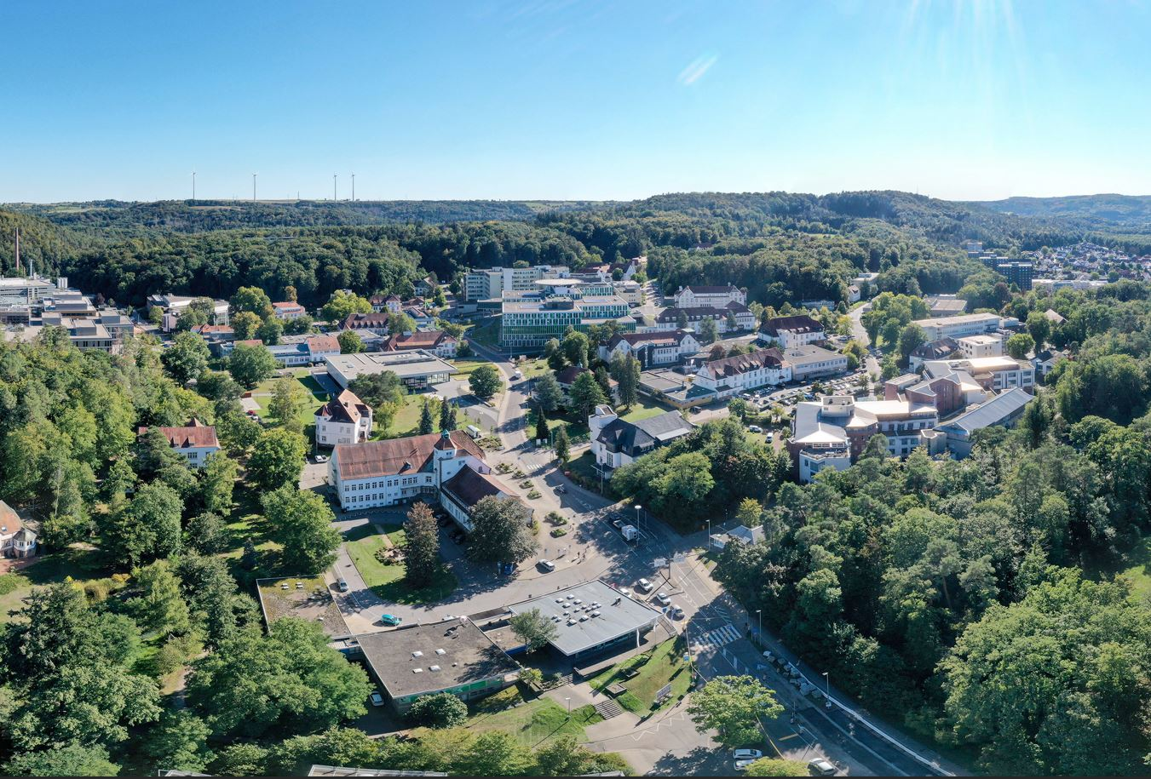
Homburg campus
Saarland University Medical Center and Faculty of Medicine

Slide 6
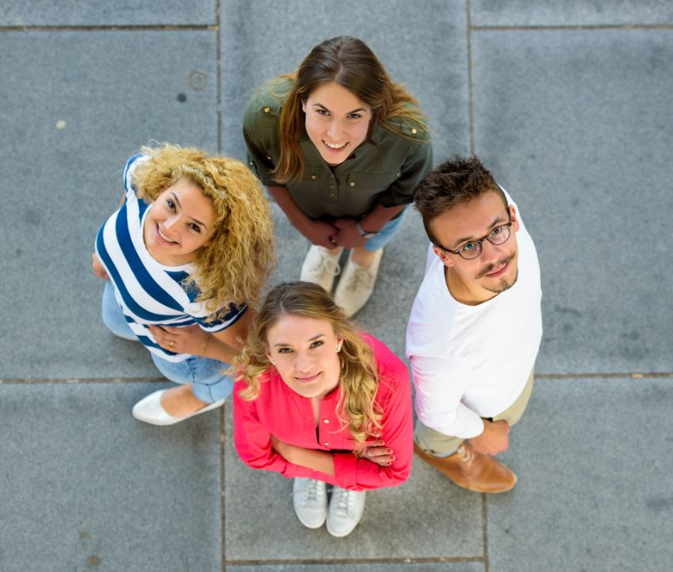
The university’s greatest asset? Our staff and students
We have
approximately 17,000 students, of whom 22 percent are international students
around 294 professors and junior professors
approximately 1600 academic research associates
around 1400 student teaching and research assistants
around 50 trainees and apprentices
Saarland University is one of the largest employers in Saarland, with a workforce of around 4900.

Slide 7
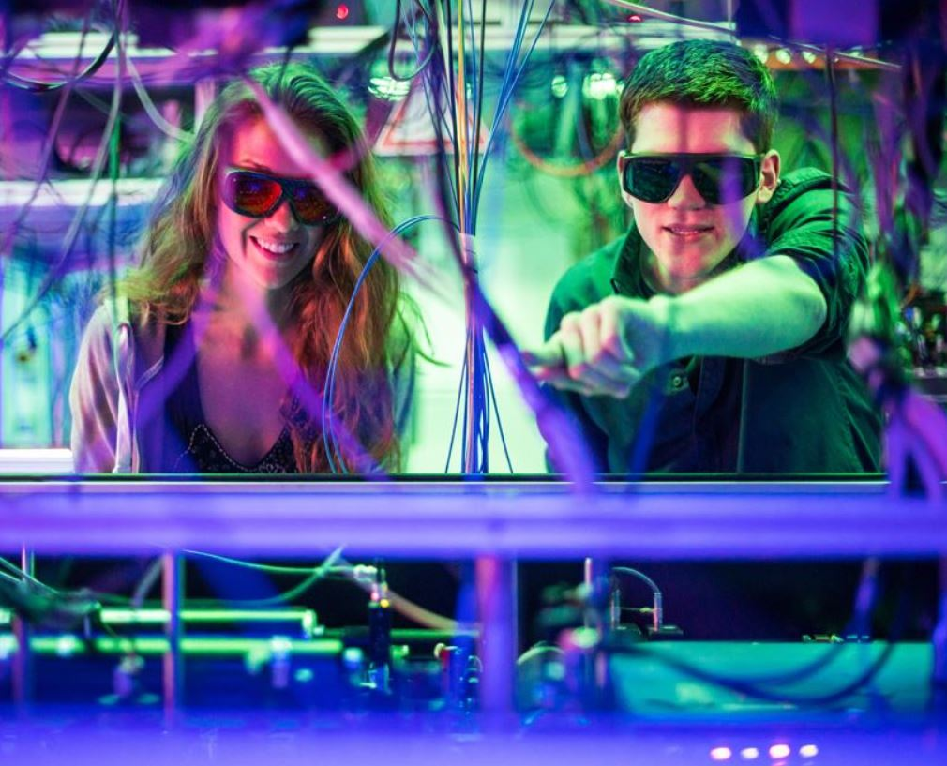
Cutting-edge research
The Saarbrücken and Homburg campuses deliver diverse, internationally respected and award-winning research
7 Collaborative Research Centres and transregional CRCs
5 sub-projects in external CRCs
numerous ERC Grants and national and international prizes and awards
Multiple research and cooperative projects around the world, including several dozen projects within the EU’s Research and Innovation programme Horizon Europe; hundreds of projects funded by the German Research Foundation (DFG) and the Federal Ministry of Education and Research

Slide 8
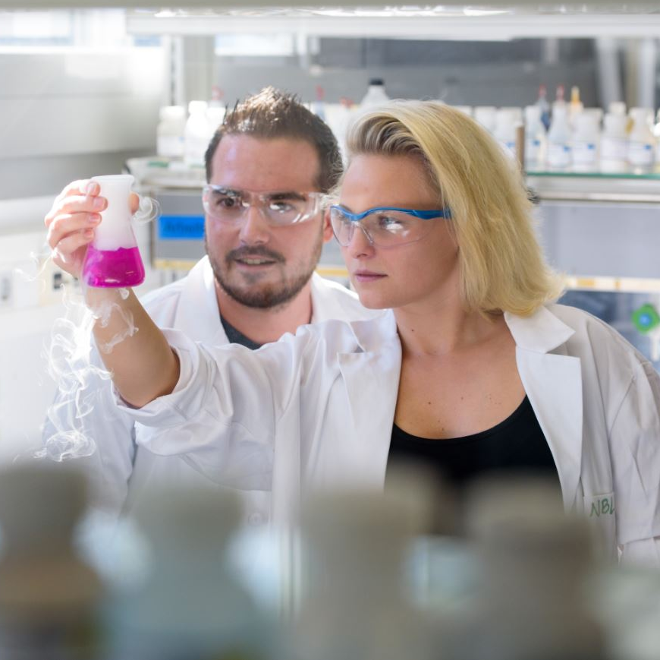
Computer Science
NanoBioMed – Life Science and Materials
Europe
Our core strategic research areas

Slide 9
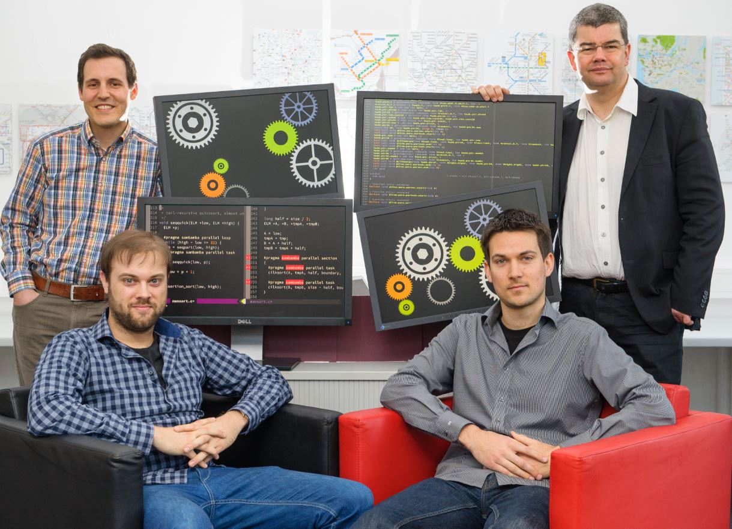
Saarland Informatics Campus – A global player
Saarbrücken is one of the world’s leading centres for computer science and informatics
Researchers at SIC have received multiple awards: 40 ERC Grants, 7 Leibniz Prize winners
1000 research scientists
3 university departments that collaborate very closely: Computer Science, Mathematics, and Language Science and Technology
5 world-renowned research institutes 77 research groups, 540 PhD students
2800 students from more than 80 countries
24 undergraduate and graduate degree programmes

Slide 10
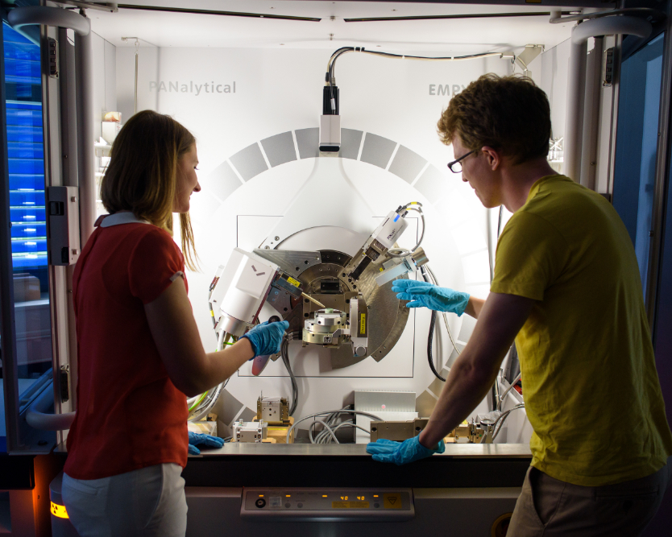
NanoBioMed – Multidisciplinary collaboration at its best
Where science and medicine meet
Top-level research at the interface of Medicine | Pharmaceutical Science | Life Sciences | Bioinformatics
Close interdisciplinary collaboration between: Biological Sciences, Chemistry, Pharmaceutical Science, Clinical and Theoretical Medicine, Computer Science, Physics, Systems Engineering, Materials Science and Engineering, as well as the cross-faculty centres for Human and Molecular Biology, Bioinformatics and Biophysics and the:
numerous prestigious external research institutes located on or near campus

Slide 11
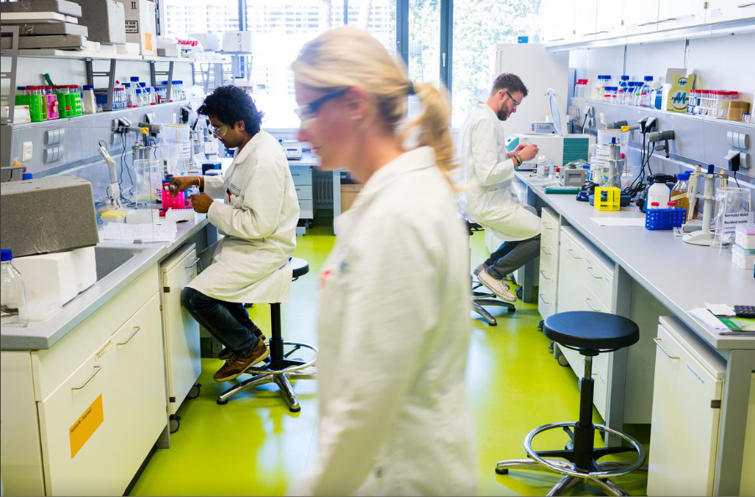
PharmaScienceHub
Cooperation platform between the Saarland University and the Helmholtz Institute for Pharmaceutical Research Saarland (HIPS)
The goal: Accelerated drug discovery and development
Over 70 research groups and more than 300 researchers working in a wide array of disciplines
Cooperative ties to 20 regional and supraregional companies, research partnerships with nationally and internationally active players in the pharmaceutical and biotech sectors
More than a dozen successful tech spin-offs

Slide 12
Europe! European through and through!
Interdisciplinary European research in all faculties, with special focus on France
‘European University’: Transform4Europe The cross-border university alliance University of the Greater Region
Numerous degree programmes and certificates (e.g. the Europaicum) with a strong European focus
European studies programme with a choice of three areas of specialization
Cluster for European Research CEUS | Käte Hamburger Centre for Cultural Practices of Reparation (CURE) | Frankreichzentrum | Europa-Institut with its sections Law and Economics | Centre juridique franco-allemand…

Slide 13
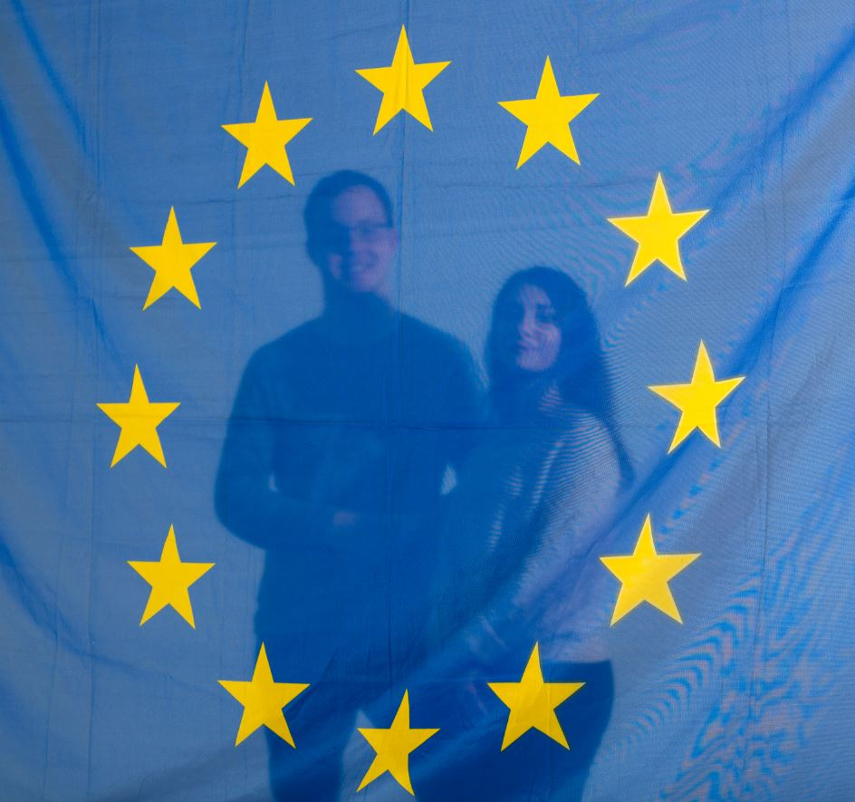
A university alliance for
a new generation of
young Europeans
who collaborate across subject boundaries to acquire digital, intercultural and entrepreneurial skills
European higher
education and training
for 150,000 students
offering
joint study programmes,
shared platforms, innovative approaches to teaching and an extensive mobility programme that facilitates close links between the eleven universities in the
T4EU alliance
European University:
Transform4Europe
T4EU
An EU-supported initiative since 2020
Eleven
partner universities in Bulgaria, Estonia, France, Italy, Lithuania, Poland, Portugal, Slovenia, Spain, Ukraine (associate partner) and Germany

Slide 14
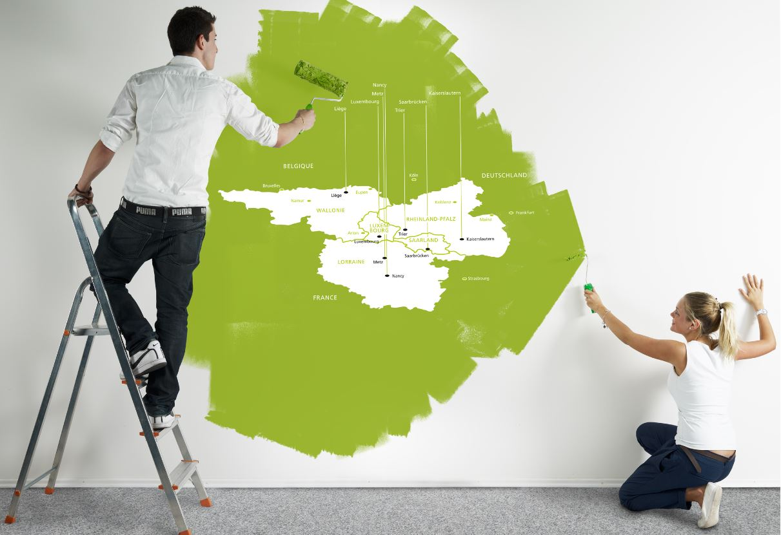
A dynamic network in the heart of Europe:
The University of the Greater Region
Seven universities in Germany, France, Belgium and Luxembourg

Slide 15
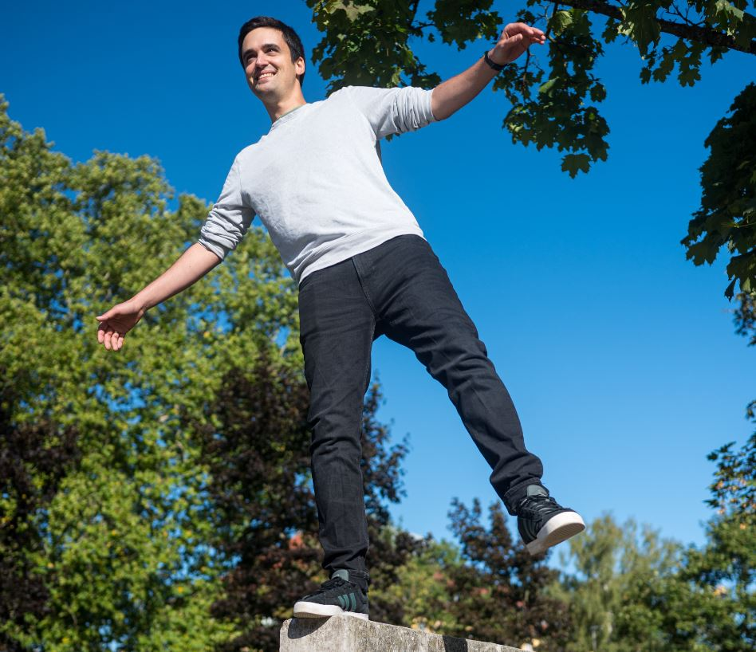
What makes us special? Transcending boundaries
At Saarland University one of our great strengths is our ability to transcend the boundaries typically drawn between cultures, academic disciplines, economies and societies.
A campus where everything is close at hand fosters interdisciplinary collaboration and encourages close ties between research and teaching.
Interdisciplinary cooperation has always been a defining feature of Saarland University. Examples include business informatics, legal informatics and bioinformatics, language technology, nano-biotechnology, cultural studies in historical perspective, intercultural communication, quantum engineering.

Slide 16
All the big players in one place
Research networks provide an excellent working environment for early career researchers
CISPA – Helmholtz Center for Information Security | German Research Center for Artificial Intelligence (DFKI) | Max Planck Institute for Computer Science Max Planck Institute for Software Systems | Dagstuhl Castle – Leibniz Centre for Informatics
Helmholtz Institute for Pharmaceutical Research, Saarland (HIPS) | Leibniz Institute for New Materials (INM) | Fraunhofer Institute for Biomedical Engineering (IBMT) | Fraunhofer Institute for Non-Destructive Testing (IZFP)
Steinbeis Research Center for Amorphous Metals Steinbeis Materials Engineering Center Saarland (MECS) | Institute for future energy and material flow systems (IZES) | Center for Mechatronics and Automation Technology (ZeMA) | Korea Institute of Science and Technology Europe (KIST Europe)

Slide 17
Studying at Saarland University: Variety and depth
A total of 160 study programmes:
80 undergraduate degree programmes – Bachelor’s degrees / state examinations (Staatsexamen)
63 Master’s degree programmes
15 advanced professional study programmes
35 international degree programmes, most of which lead to a double- or triple-degree qualification Over 25 certificates offering supplementary qualifications in specialist fields
Language Centre: choose from over 15 languages

Slide 18
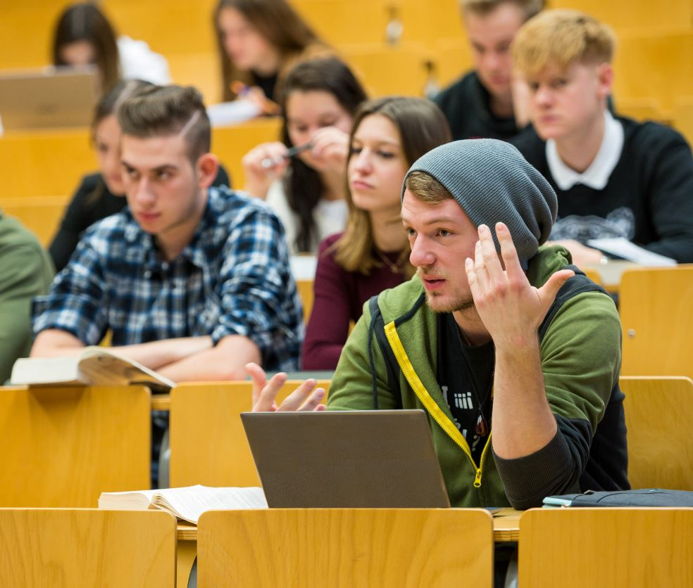
Officially recognized for teaching excellence
Saarland University was one of the first universities in Germany to receive official quality assurance accreditation for providing an ideal environment for successful academic study.
Effective quality management: Continuous development and improvement of teaching and study programmes
As a medium-sized university with a reputation for excellence, Saarland University offers personal academic supervision with students often learning in small groups.
Teaching and Learning Centre: Acquisition of cross-disciplinary skills

Slide 19
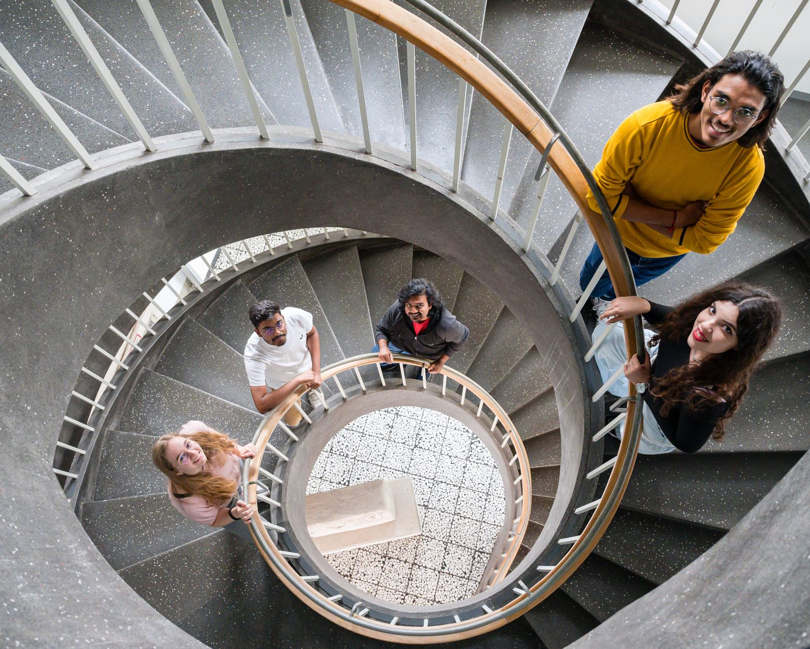
Getting off to a good start!
Preparatory courses and mentoring initiatives help students just starting out at university.
Study programmes that offer students opportunities to put their knowledge and skills into practice.
Students can contribute to departmental and institute research projects at an early stage of their university education.
The Career Center can assist with career planning and with transitioning from university to the workplace. Students can take their first steps in a business start-up while still studying.

Slide 20
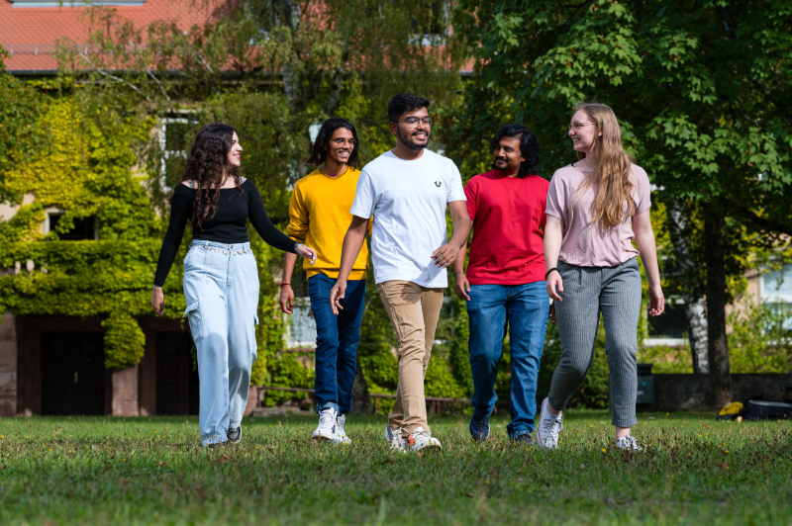
Opportunities around the world
The International Office is the main coordinating office for incoming international students and for home students looking to study abroad.
Exchange programmes for university research and teaching staff at hundreds of partner universities around the world, many of which are in Europe.
Support for students who want to organize a study abroad period outside of existing exchange programmes. Opportunities for international work placements and internships.
The Welcome Center assists international students and visiting foreign academics and scholars.

Slide 21
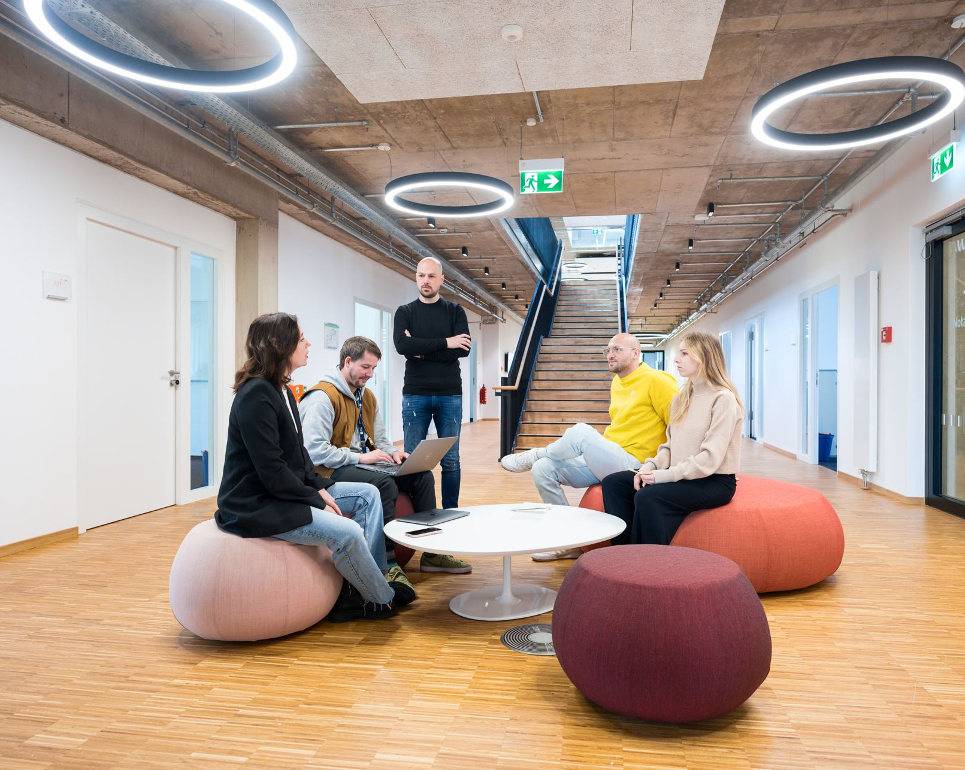
Our Third Mission: Triathlon – Driving Entrepreneurship!
Centralized structure: Triathlon – Entrepreneurship, Innovation and Transfer
An outstanding start-up culture – Saarland University was awarded third place in the highly competitive international Triple E Awards in the category ‘Entrepreneurial University of the Year’ (Europe)
and ranked second in the national ‘Start-Up Radar’ league tables published by Stifterverband – a key funding organization in the German higher education landscape
Recognized by the federal government in its EXIST Business Start-Up programme

Slide 22
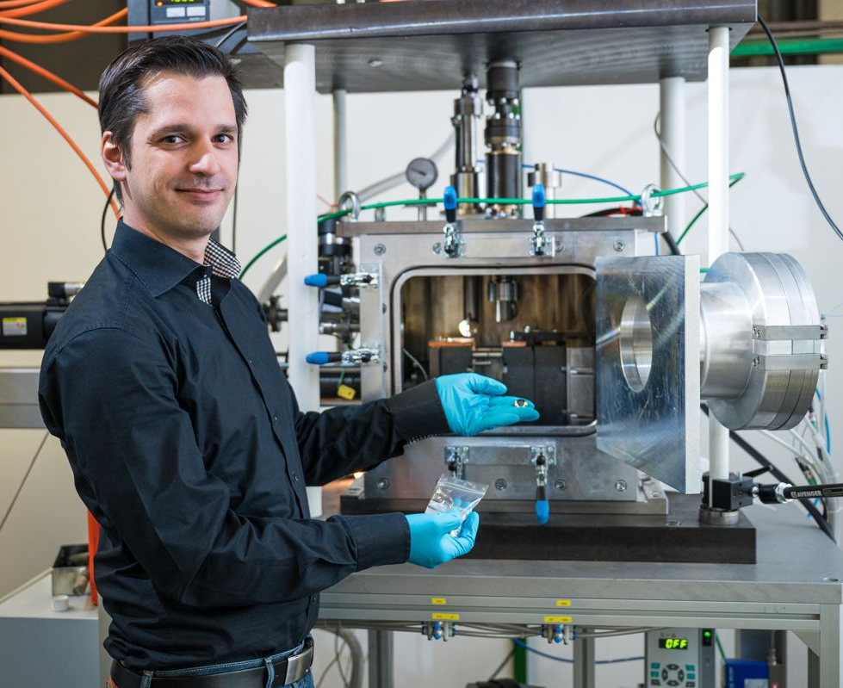
Our Third Mission: Entrepreneurial spirit!
Young entrepreneurs benefit from outstanding guidance and support services, which are also available to students before they graduate.
3 incubator centres: more than 520 start-ups
Innovation Center
Science Parks I and II located right next to campus
Active technology transfer
Patent utilization agency
Continuing Education: CEC Saar

Slide 23
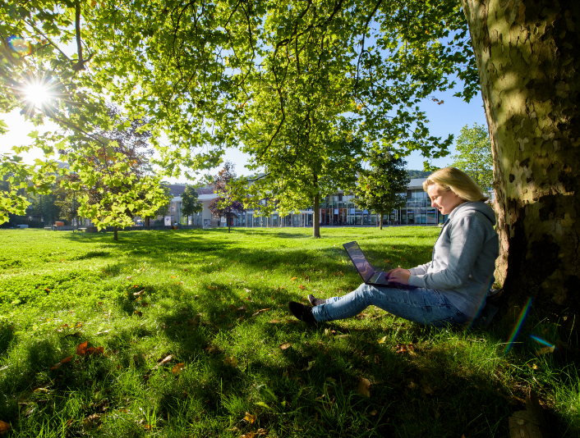
Our Third Mission – Sustainability
We’re working together to embed sustainability as a core element of our university culture
Sustainability Committee with its numerous specialist working groups
Multiple projects, initiatives and events already in place to promote sustainability in research, teaching and university operations
Driving innovative research Raising public awareness of sustainability
The university as a role model: Fostering social and economic responsibility in all that we do

Slide 24
At the heart of Europe and with global reach Picture credits: Oliver Dietze, dasbilderwerk (14), BeckerBredel (4), Benjamin Treib/Saarcopter (5), Universitätsarchiv (2)

