Slide 1
The University of Portsmouth presents:
STUDY ABROAD

Slide 2
THE CITY
Portsmouth is a vibrant,
sea-side city with a rich
history
On the South coast
Within easy reach of London
Easy access to the popular
Isle of Wight
Naval port with car ferries
to Brittany

Slide 3
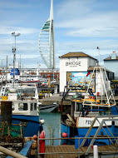
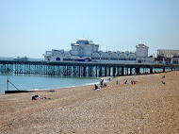
The City
Historical yet modern
Exciting yet relaxed
So much to do!

Slide 4
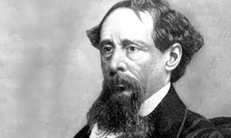
The City
Rich heritage
Home to the Royal Navy
Historic Dockyard with famous ships:
HMS Warrior, the Mary Rose, Lord Nelson’s famous HMS Victory
Literary heritage:
Dickens
Doyle
Austen
Kipling
Wells

Slide 5
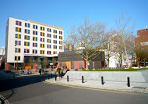
The University
Because of its literary heritage, Portsmouth is the perfect place to come and study English Literature

Slide 6
English at Portsmouth
High-quality teaching by academics who are research-active and (inter)national leaders in their fields
Great student satisfaction
Excellent support
Good facilities
Emphasis on employability

Slide 7
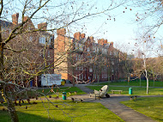
English at Portsmouth
Why should you study English at Portsmouth?
Study English with English students
Improve your spoken / written English
Attend activities organised by our Research Centre
Take part in the very active British student life
Immerse yourself in English culture

Slide 8
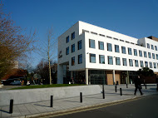
English at Portsmouth
Choose from a wide variety of courses
Courses might include:
Writing Now
Shakespearean History
American Literature
Crime Writing
Margaret Atwood
Magical Realism
Early Modern Literature and the Bible
European Literary Decadence
Post-Modern Historical Fiction

Slide 9
English at Portsmouth
Join us for one teaching block (September to December) or the whole academic year
Teaching is through lectures, seminars, tutorials or workshops
Various forms of assessment: exams, essays, portfolios, presentations.
You will be awarded credits on successful completion of your units.
As a ‘Study Abroad Student’ you will choose three different units, achieving up to 60 credits

Slide 10
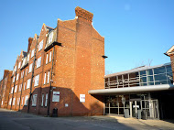
English at Portsmouth
Entry Requirements:
Grade Point Average of 2.5
Minimum English language level of IELTS 6.0 or TOEFL 89.
Letter of recommendation from one of your tutors.

Slide 11
Fees
Study Abroad Fees:
One semester: £4,500
Full year: £9,000

Slide 12
The Student Voice
I always knew that I wanted to spend my “study abroad time” in England and after Dr.Berberich had presented the University of Portsmouth in Saarbrücken I chose it as my study abroad destination. I really enjoyed my time at the University of Portsmouth. I experienced a lot of support and help during my time at Portsmouth. The organization at the university and the help I received from all staff members was a great experience. For international students the International Office is the main contact point in terms of requests and questions and their assistance was valuable. What surprised me the most was to see the student life which was offered by the university, including my most favorite, the Students’ Union, a place run for students by students, which is a popular venue for all students in the evening. The variety of trips, events, clubs, and societies offered via the Union was also an incredible surprise for me. Portsmouth itself is a lovely British city, which offers a historic background on the one hand and a vivid student life on the other. It was great to experience the British lifestyle and culture whilst living with other students and thanks to the Students’ Union I could take part in trips to see some other famous cities. My semester abroad was an unforgettable experience I wouldn’t want to miss. (Olga Stern, Study Abroad Student, autumn 2012)

Slide 13
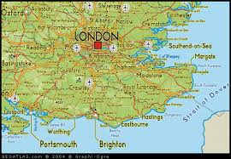
Things to Do
Portsmouth & Southsea seaside resort
Close proximity to seaside resorts of Brighton or Bournemouth
Close to historic cities such as Chichester or Winchester
London just over 1hr away
Isle of Wight only
short ferry ride away

Slide 14
Things to Do
Beautiful South Downs National Park on the Doorstep
Stunning Coastline to East and West
Historic houses galore!
Stonehenge within easy reach

Slide 15
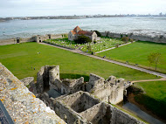

Slide 18
Contact Details
www.port.ac.uk/studyabroad
For English-specific queries contact
Dr Christine Berberich, christine.berberich@port.ac.uk

Slide 19
See you in Portsmouth!

