Slide 1
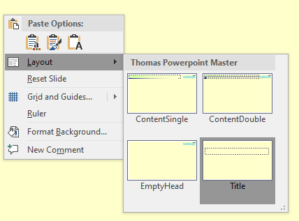
Template for Powerpoint by Thomas John the boring first page ☺
there are four predefined styles, right
mouse click to switch between them,
this is an empty head slide
some suggestions:
• the font is always Calibri, not Arial or worst case Times New Roman, Times has Serifs, only useful for quick
reading in books
• use only a limited number on font sizes, not more as three
• to enter special characters like this bulled use the
character map in windows and alt+numpad numbers,
e.g. • = alt+0149, …
• to emphasize something use the predefined shape styles with white background

Slide 2
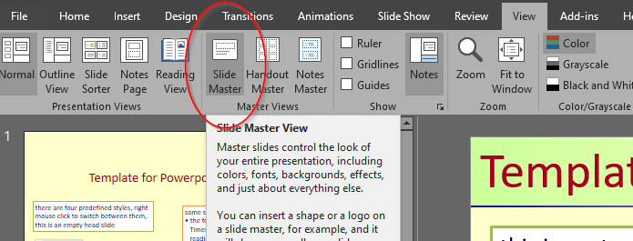
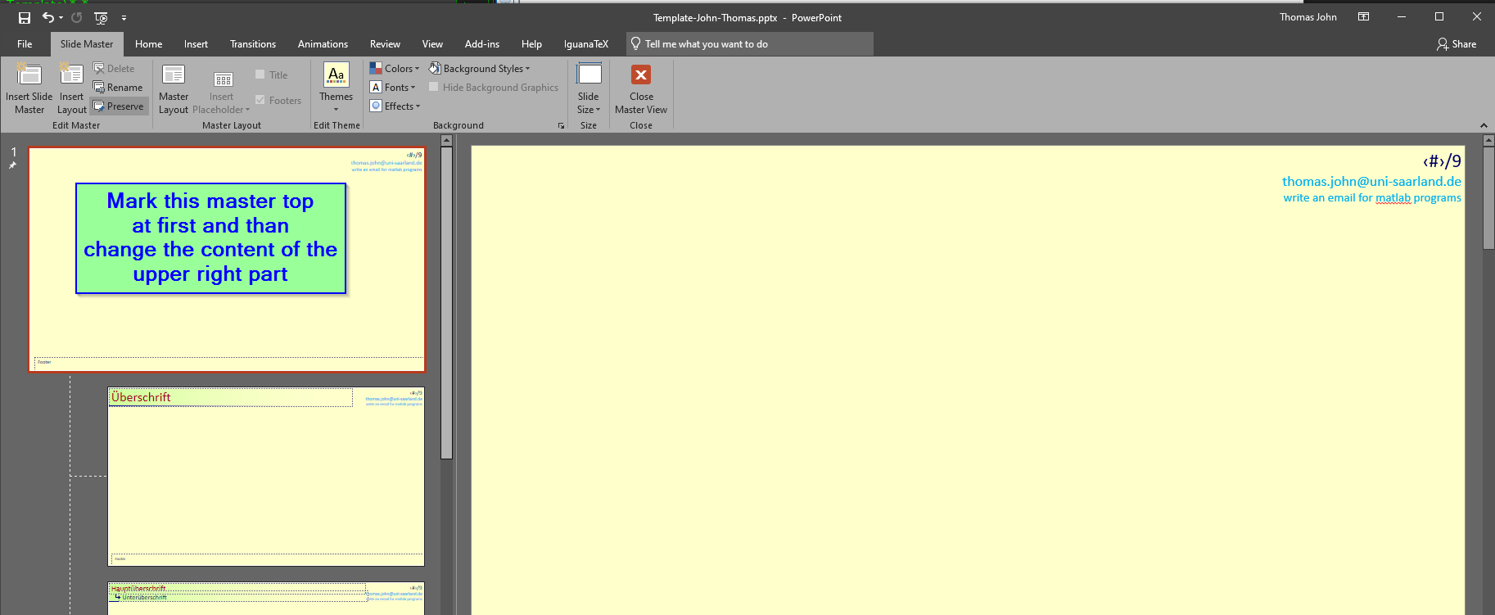
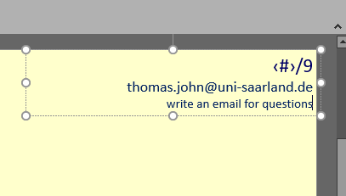
Template for Powerpoint by Thomas John
How to edit the master slide?
• the upper main master defines the
content of upper right part
this is content single line
keep in mind
• every slide should have at least a picture
• a picture is more than 1000 words
• a slide without pictures makes sleepy
• the eyes needs something to fix
• …. use pictures … for a slide show
• use short fragments of sentences only the audience should concentrate
on your speech, this is not possible if
they need time to read full sentences
• this textbox is an bad example
there is an automatic page numbering

Slide 3
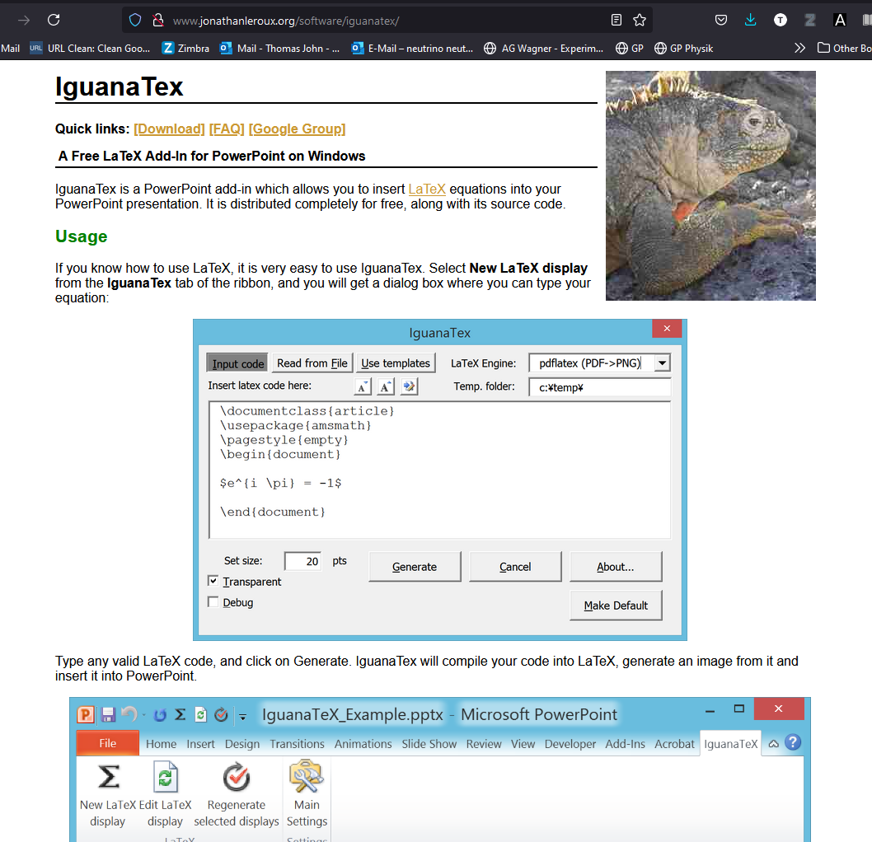
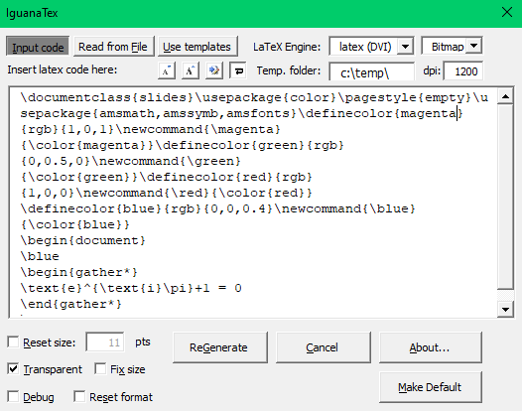
main title
• you can simply duplicate boxes with ctrl+d,
this preserves the language settings
• if you need to switch the language (spell checking)
for many slides, you can use a tool called language fixer
https://www.janschejbal.de/projekte/languagefixer/
subtitle
this is a ContentDouble page
How about LaTeX
• powerpoint can handle images
very well
• lets create transparent images
of equations using Iguana TeX
http://www.jonathanleroux.org/software/iguanatex/
My suggestion,
use this equation, duplicate it and modify it
as picture you
can shadow it
those template equation includes already
many common packages as well as colours
here blue
or put a box
behind it
• you should have installed MikTeX
you can use text in latex too,
the latex font is very similar to calibri

Slide 4
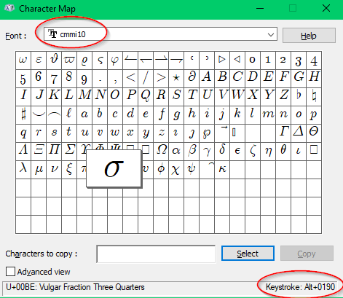
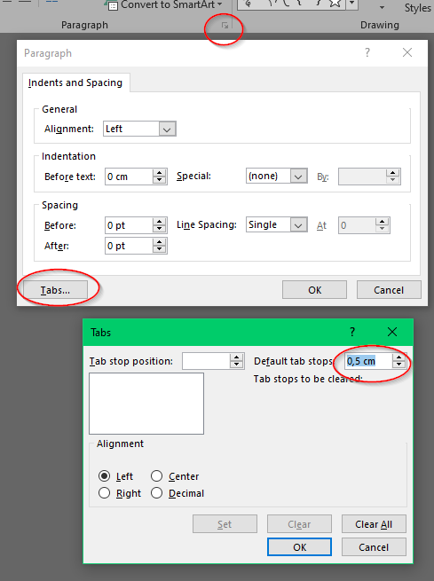
main title bla bla
How about writing in powerpoint LaTeX
• powerpoint can handle many fonts too, I suggested to
install few latex fonts as ttf font form
https://ctan.org/tex-archive/fonts/cm/ps-type1/bakoma/ttf?lang=de download
cmmi10.ttf – math fonts and Greek letters
cmmib10 – the same for bold fonts
cmss10.ttf – sans serif font (you can use Calibri too, very similar)
download and right click on the file -> install, thats is
so you can use latex letters inline in text like this S = ¾
• or in Calibri this dot • is simply
Alt+0140 , note the 0149 need to enter on the num key pad. ,
see the “Character map” of the font Calibri
• the sigma above is e.g. Alt+0190
• to change the tab-length, mark the text, select paragraph opt.
see right side, here 0.5cm between tabs
. . . . .

Slide 5
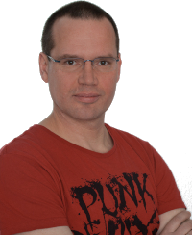
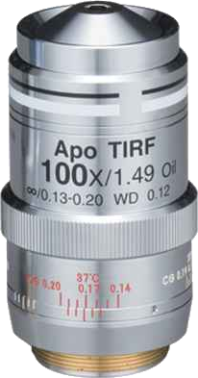
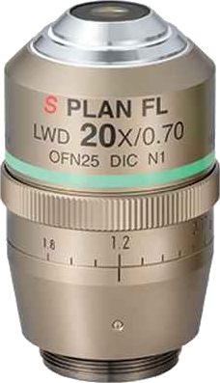
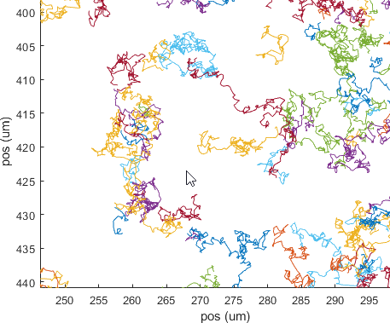
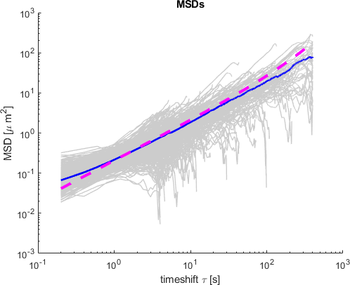
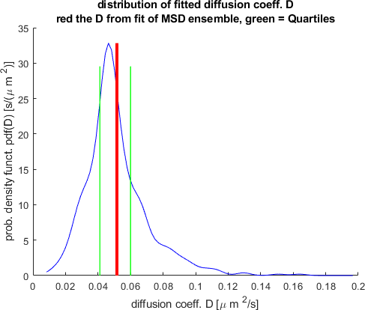
Extraction of diffusion coefficient and anomalous exponent
from the MSD, log-log versus (non)linear fitting
Thomas John*, Patrick Galenschowski, Enkeleda Meziu and Christian Wagner : University of Saarland, Germany
start at 11:00am
Outline
50µm
passive microrheology
What objective
should I use?
particle tracking
Brownian motion
??
Mean Square Displacement
(MSD) analysis
How to fit
the data?
goal:
diffusivity, (local) viscosity,
anomality ….
Heterogeneity?
How to inter-
pret the data?

Slide 6
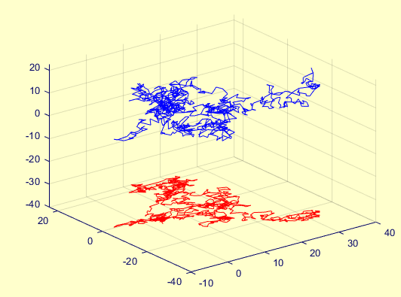
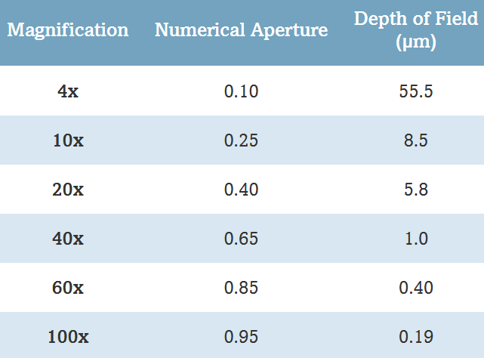
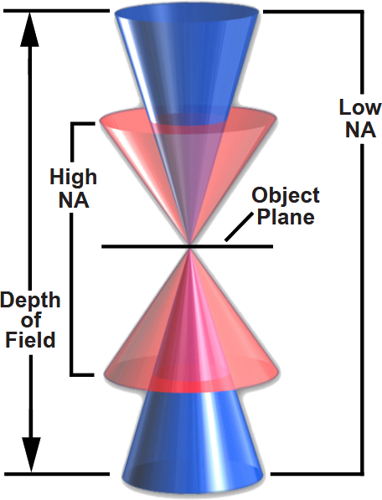
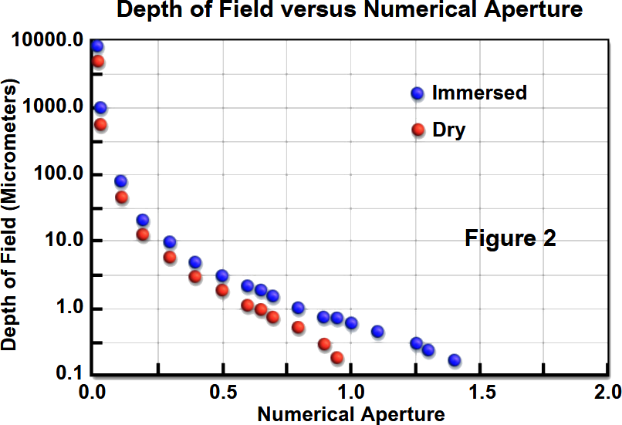
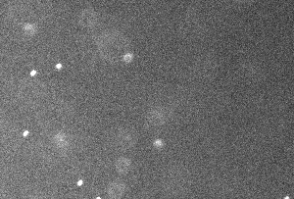
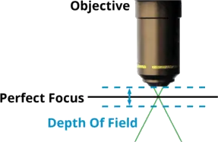
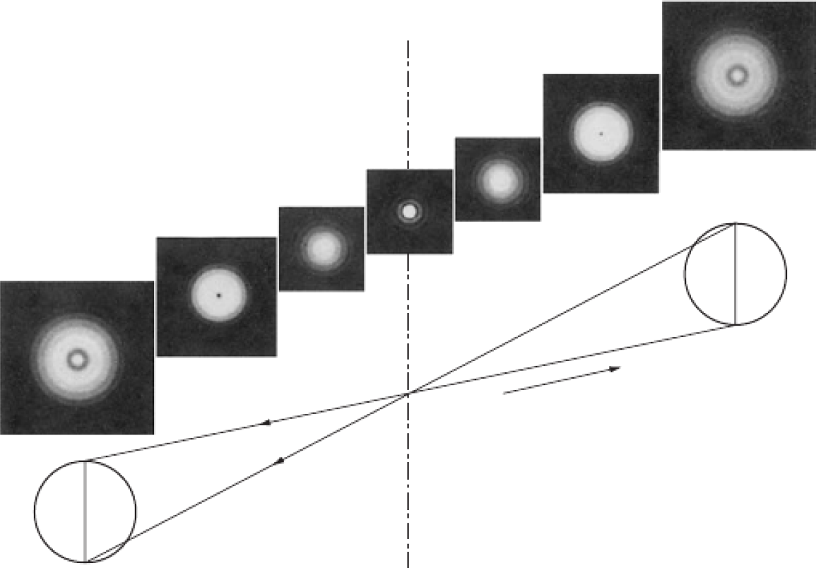
Observation Techniques – Magnification
3D-trajectory
space
2D-projection
=> Do not use high magnifications!
50µm
space
space
??
requirements: long trajectories
particles - Ø 100 nm
problem: limited depth of field
Bass, Handbook of Optics; https://dovermotion.com/applications-capabilities/automated-imaging/microscope-calculations/; https://www.microscopyu.com/microscopy-basics/depth-of-field-and-depth-of-focus

Slide 7
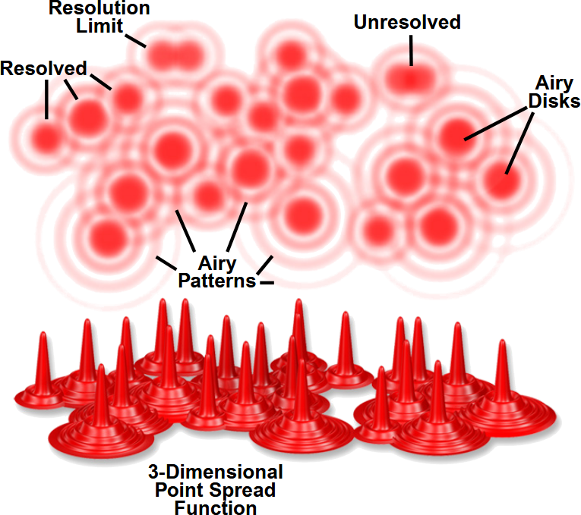
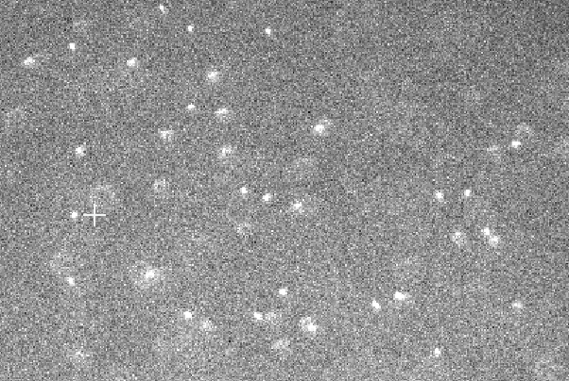
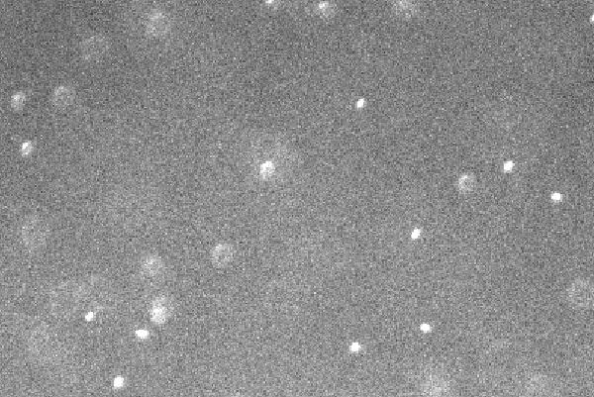
observation techniques – resolution/NA
=> you can see only the point spread function
=> center position also very accurate in ‘unsharp’ pictures
=> use low magnification and low NA objectives, e.g. 20x, air, NA 0.45
but in fluorescence observation
biggest issue low light intensities ☹
=> better high NA to collect more light
particles - Ø 100 nm
examples
20x, NA 0.4 low light
=> difficult to detect
20x, NA 0.7 many out of focus,
but more light
=> better detection
1 pixel = 3x particle Ø
20 µm
20 µm
20 µm
https://dovermotion.com/applications-capabilities/automated-imaging/microscope-calculations/; https://www.microscopyu.com/microscopy-basics/depth-of-field-and-depth-of-focus

Slide 8
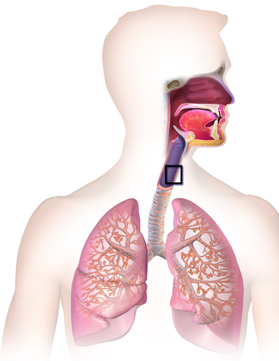
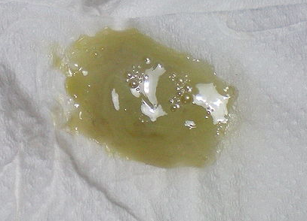
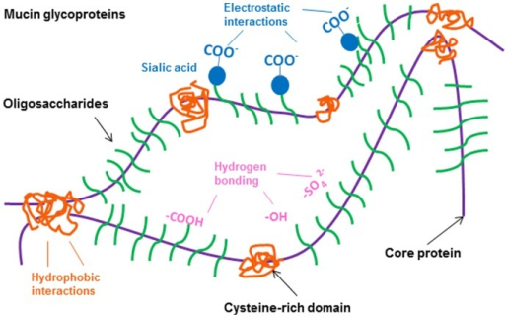
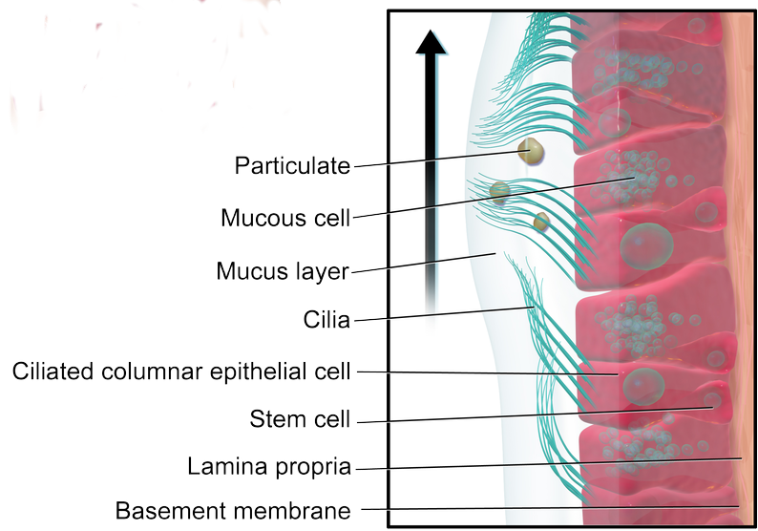
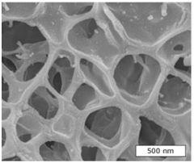
scientific question: heterogeneity in mucus
chemical composition:
mucins are a family of high molecular weight and heavily glycosylated proteins
sputum
mucus =
95% water + scaffold
mucus
Lieleg et al.,
Trends in Cell Biology 21 543 (2011)
= particles
Can we distinguish
between various ‘cells’
by microrheology
experiments?
scanning electron microscope image
Is this bubble structure true? [Kirch et al. PNAS 2012]

Slide 9
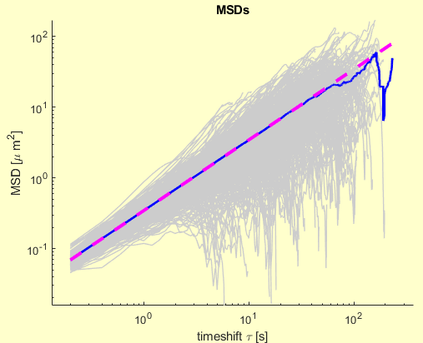
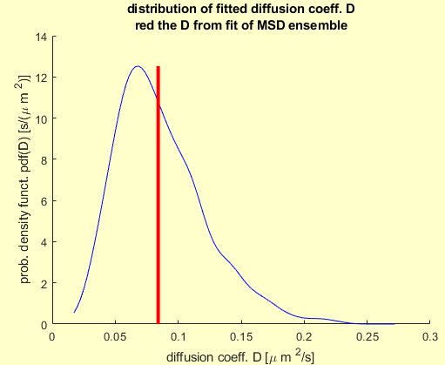
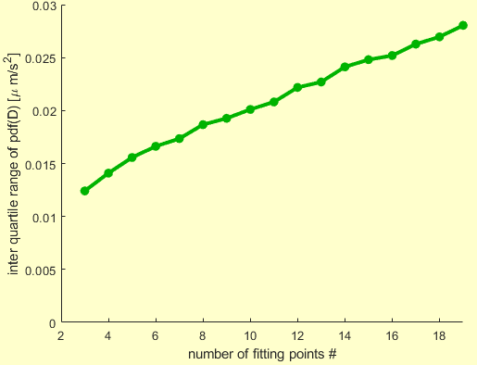
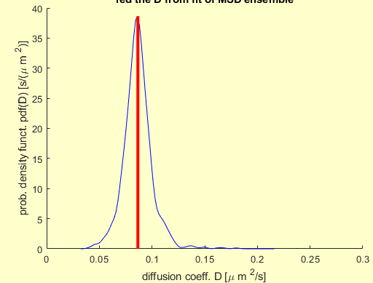
fitting of simulated data – closer view
width of the distribution
of fitted diffusion coefficients
take first 30% of
each MSD for fitting
! take only the first
points of MSD for fitting !
take only first 3 points of
each MSD for fitting
there is always a broad
distribution due to finite
trajectory length ☹
filename = 'd:\thomas\work\00_Object-Tracking\Enkeleda\x100nm-na045-h2015-gl85-5fps-21_0_alltrac2021-03-23-18-01-56.mat ';

Slide 10
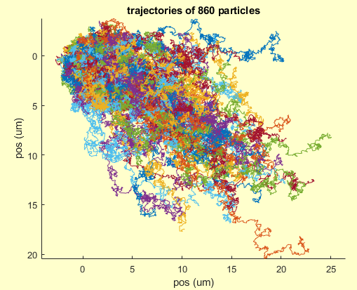
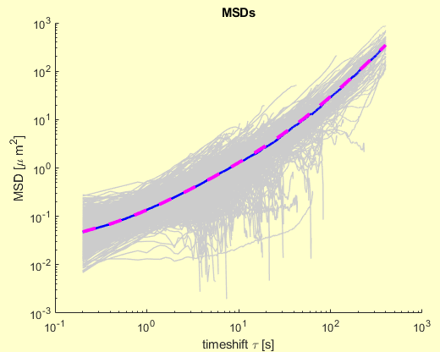
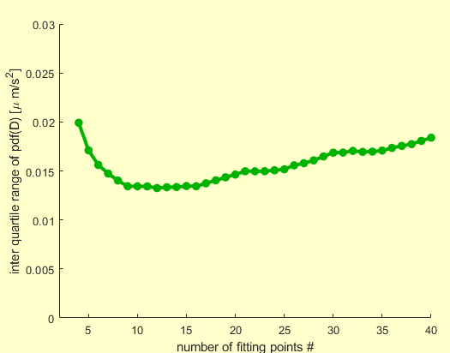
fit of experimental msd - suggestions
! take only the first
points for fitting !
extract it before
fitting and fix it
fit function
experimental data with drift
200 nm particles in gly/H₂O
uncorrelated
pixel noise
possible an anomality
be careful !!
the unit of D changes to
µm²/s®
filename = 'd:\thomas\Work\00_Object-Tracking\bla\200nm-na045-h2o15-gl85-5fps0__alltrac2021-02-12-17-57-54.mat';

Slide 11
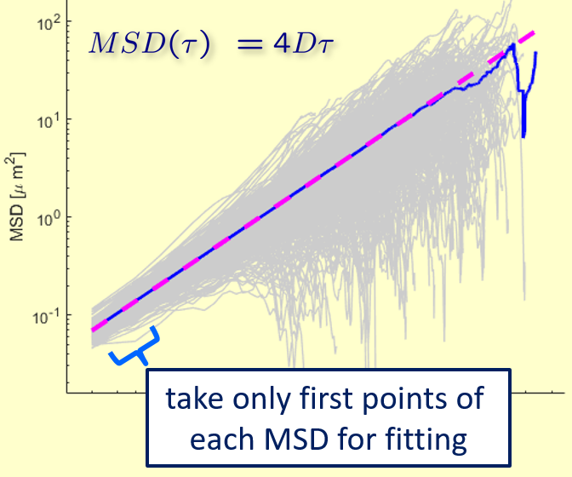
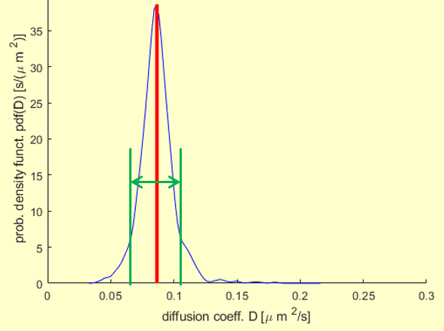
Conclusion
• you need long trajectories for a good statistics
=> do not use high magnifications
??
• fitting the MSD
=> use only the first few points
• interpretation of MSD fits
=> length limited trajectories leads
always to a broad distribution
of diffusion coefficients
• if you interest in matlab programs for particle tracking, MSD analysis and num. simulation for your own, don’t hesitate to write an email
thanks for your attention

